Slide 1
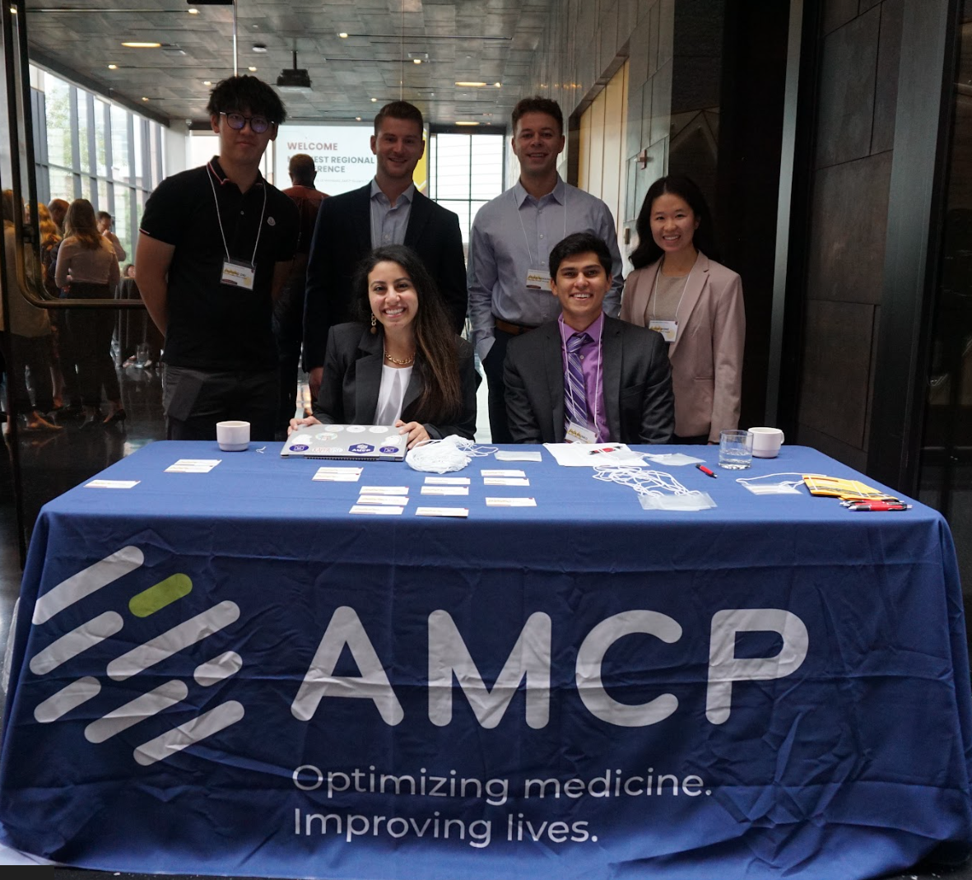
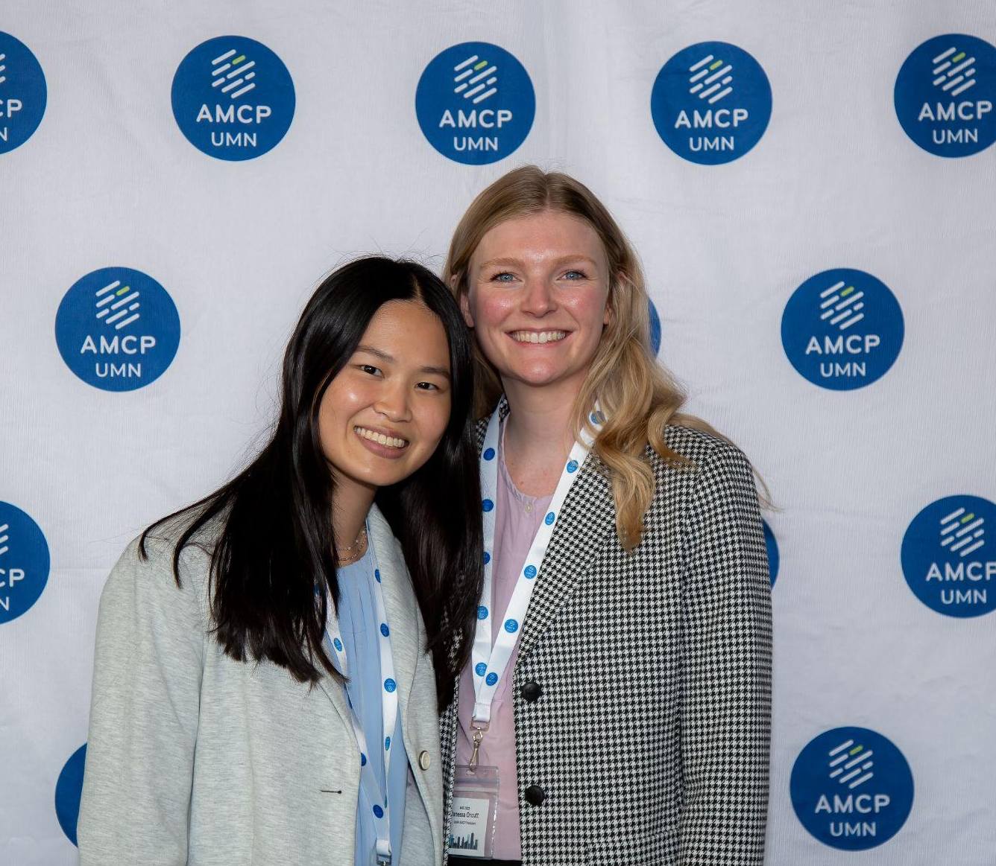
Chapter Leadership Presentation
University of Minnesota AMCP Chapter

Slide 2
Agenda
Introductions
Events
Chapter Website Overview
Tips for Recruitment and Event Planning
Connect with Us!

Slide 3
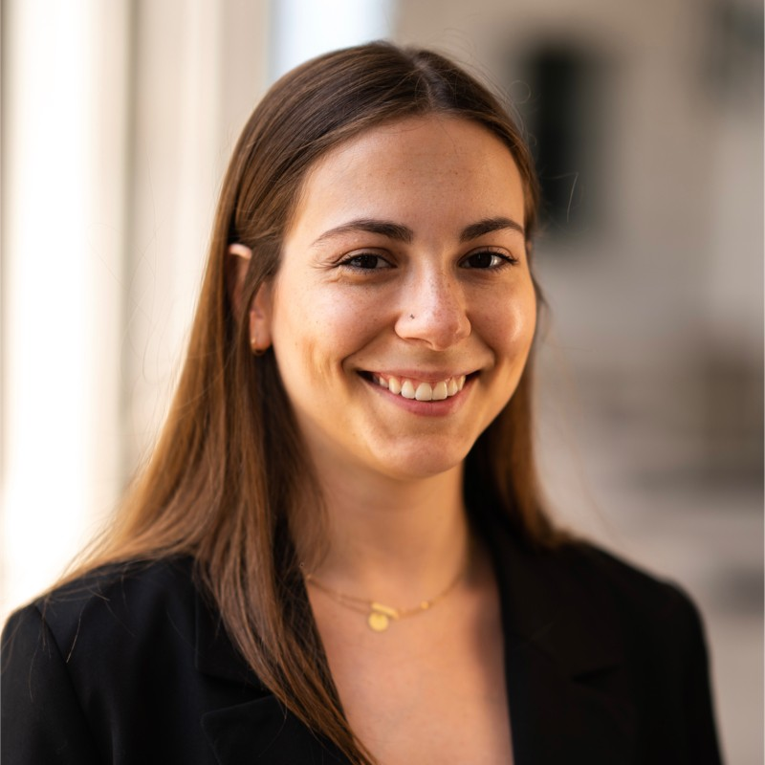
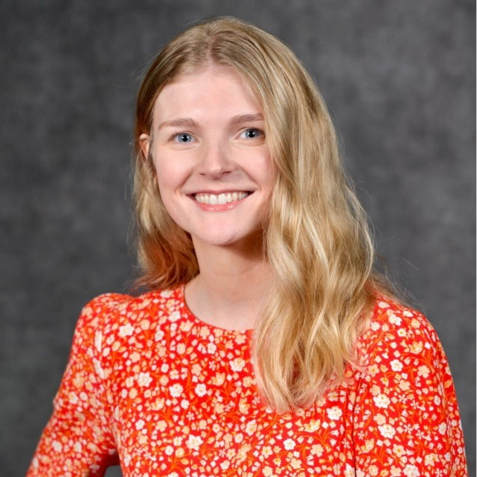
Introductions
Sophia Serafimov
Event Coordinator
(2023-2024)
Class of 2025
seraf013@umn.edu
Vanessa Orcutt
President
(2023-2024)
Class of 2025
orcut056@umn.edu

Slide 4
Chapter Vision and Goals
The University of Minnesota (UMN) AMCP student chapter is dedicated to promoting the principles and practice of managed care pharmacy.
Innovative educational and professional development programs
Promote
real-world and hands-on managed care learning opportunities
Facilitate mentorship and meaningful connections
Targeted Areas of Growth

Slide 5
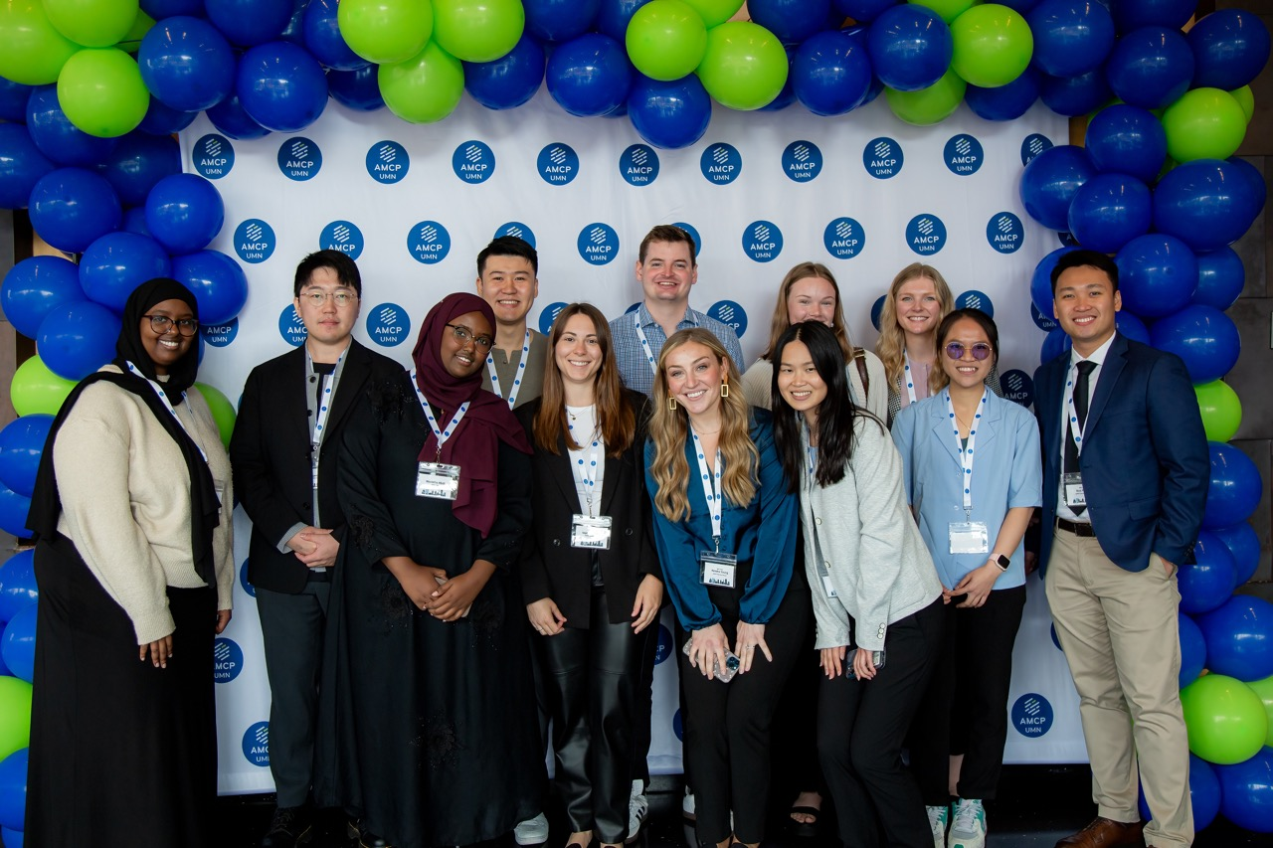
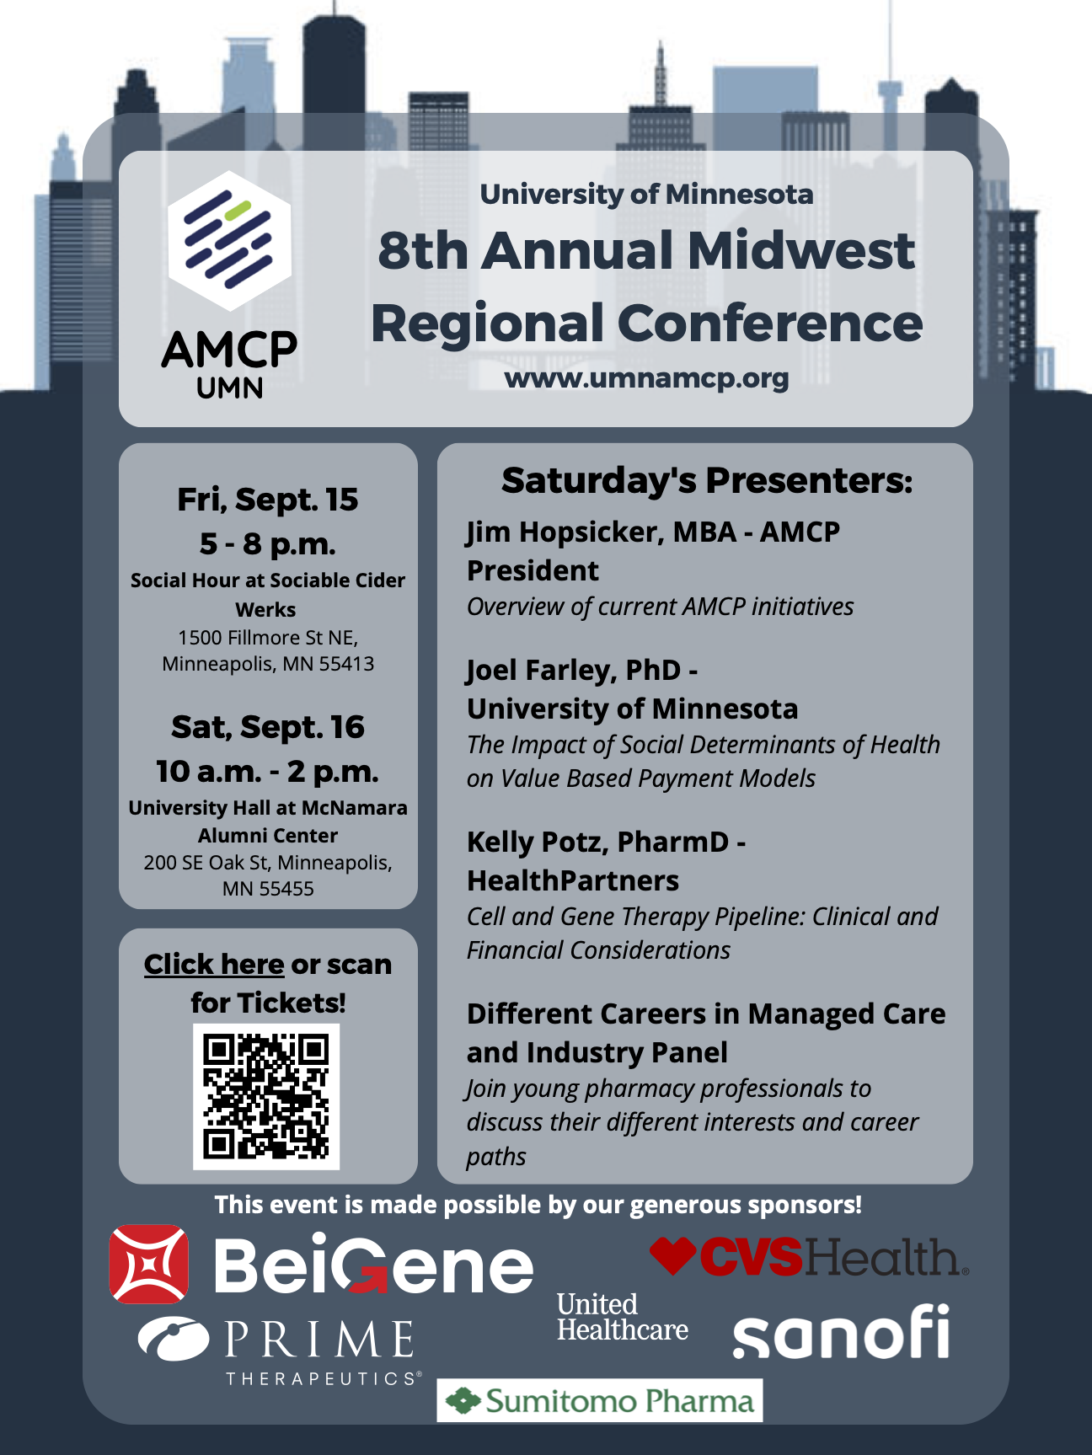
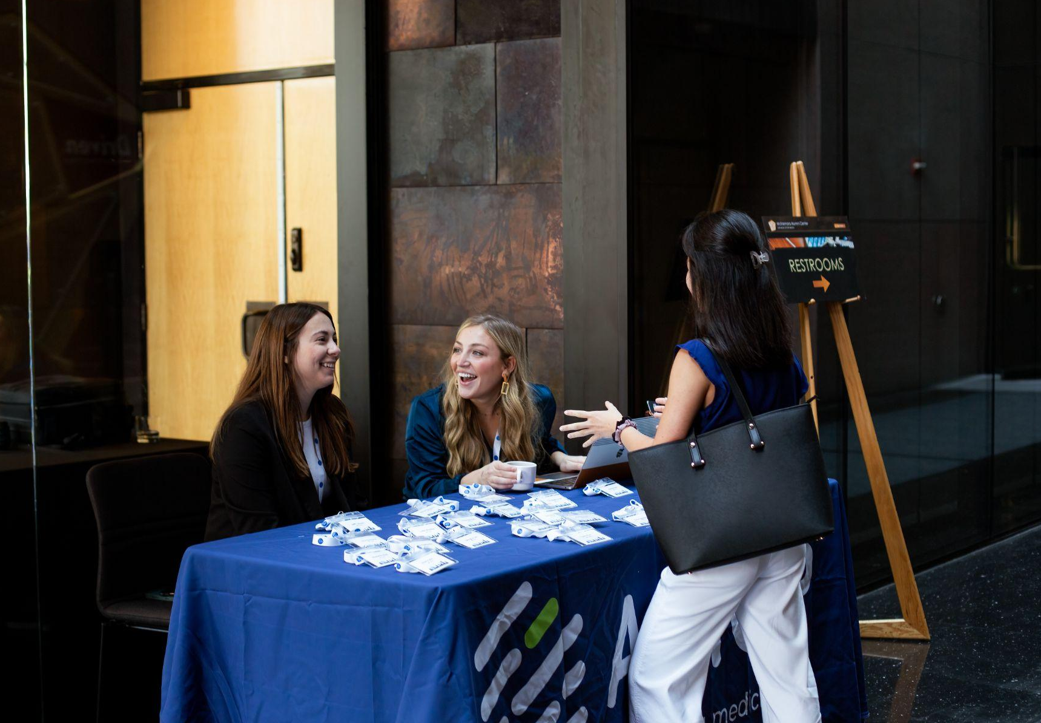
Event #1: Midwest Regional Conference
Synopsis
Two-day regional conference featuring pharmacist-led educational sessions, interactive panel discussion and professional network events including a pre-conference social hour.
Topics covered:
Social Determinants of Health
CAR-T Therapy Payment Strategies
Managed Care/ Industry Young Professionals panel
Outcome
Brought together over 60 students and pharmacists to promote managed care practice and educate on important current topics affecting payers and health systems.
Networking social hour & luncheon helped pharmacy students build professional relationships with managed care pharmacists.
Collaboration: Minnesota Pharmacy Student Alliance
Planning: 60 hr active planning, 6 months preparation
Attendance: 65

Slide 6
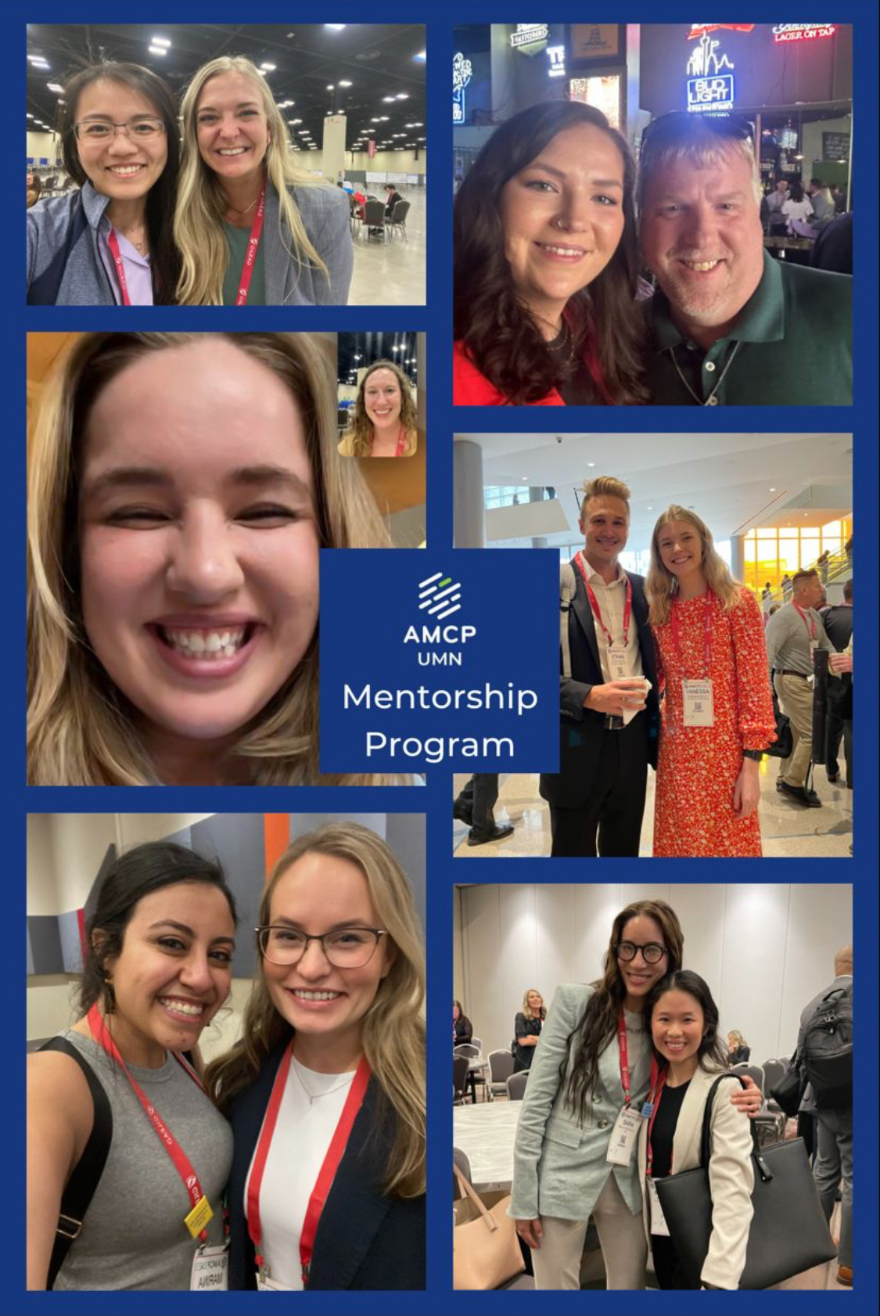
Event #2: Spring Networking Social Hour & Mentorship Program Kick-off
Synopsis
A social hour for pharmacy students to meet with their mentors in person and connect with other managed care pharmacists and industry professionals.
Released a new mentorship guide with suggested activities and an award to recognize the most active mentor-mentee pair. Five mentorship pairs were entered to win a coffee gift card to facilitate future meetings.
Outcomes
Students networked and built relationships with pharmacists from managed care and industry companies including UnitedHealthcare, Prime Therapeutics, and Boehringer Ingelheim.
Collaboration: Minnesota Pharmacy Student Alliance
Planning: 6 hr
Attendance: 25

Slide 7
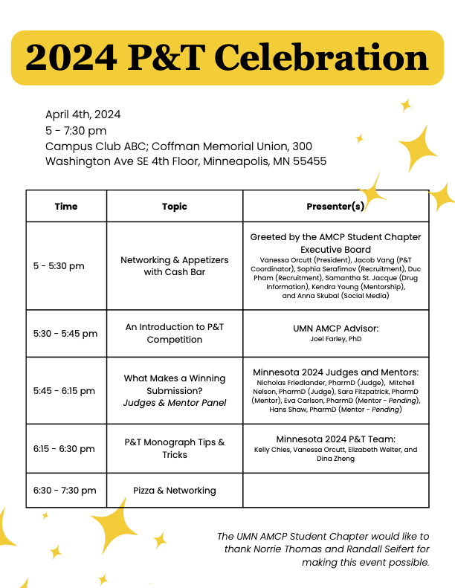
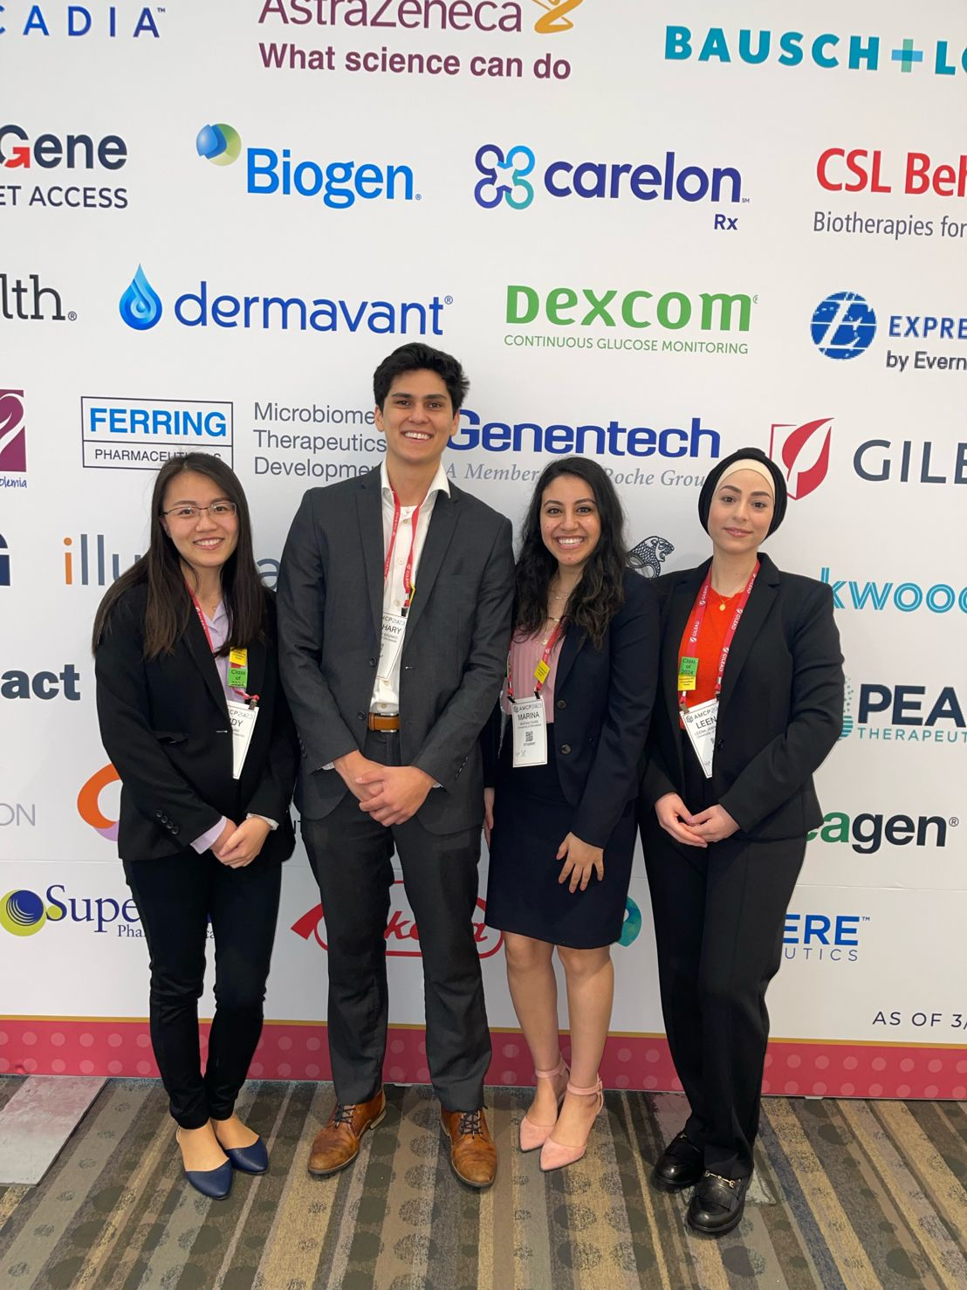
Event #3: P&T Celebration
Synopsis
An opportunity for the student chapter to celebrate all of the hard work that went into our local P&T competition while acknowledging the generous contributions of our alumni mentors and judges. This event, sponsored by UMN managed care alumni, features a short presentation from our chapter advisor, thank yous for our mentors and judges, and finally a tips & tricks presentation from our winning team.
Outcomes
All student P&T participants were able to network with local managed care professionals and learn how to improve their teamwork and communication for future P&T competition entries while simultaneously celebrating the National Top 5 placement of our winning P&T team.
Collaboration: Minnesota Pharmacy Student Alliance
Planning: 25 hr
Attendance: 22

Slide 8
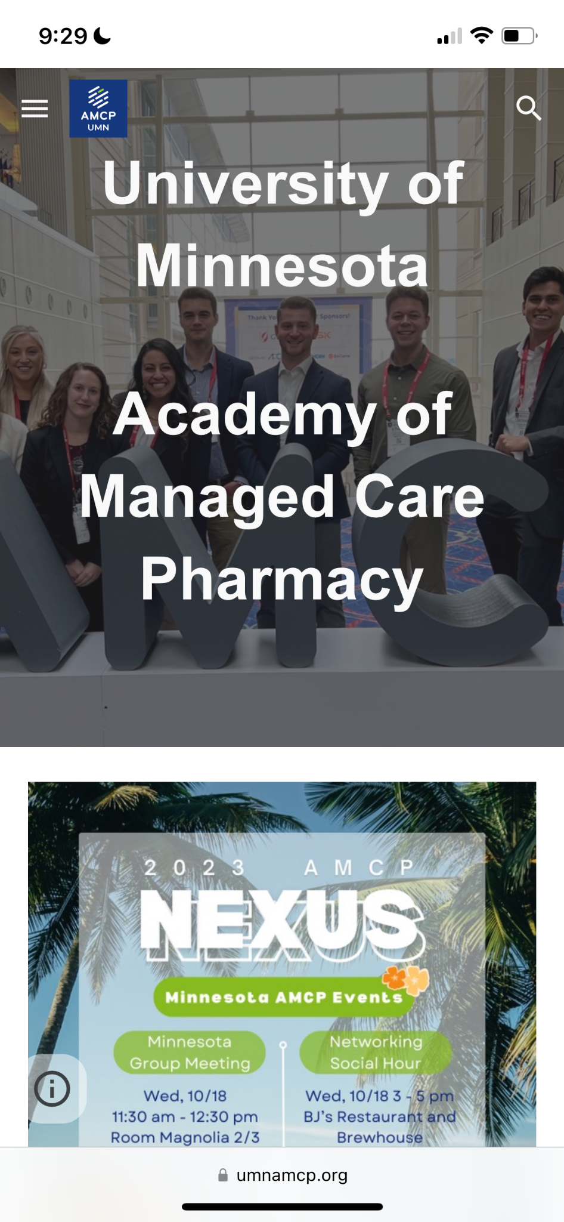
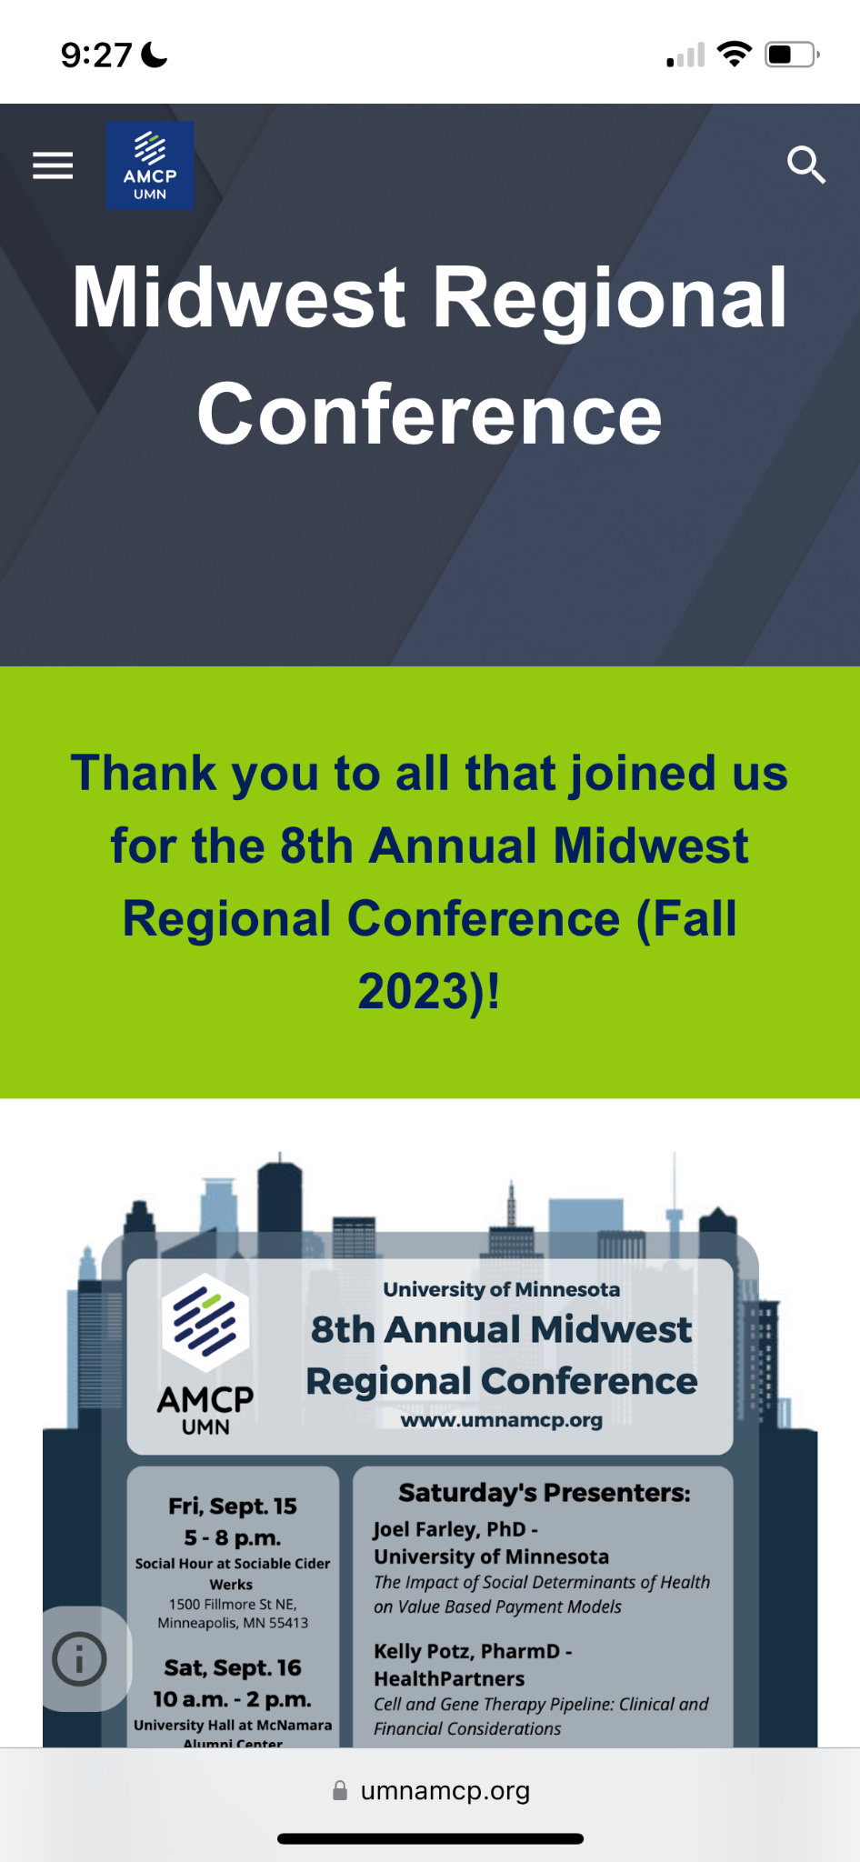
Chapter Website
https://www.umnamcp.org/

Slide 9
Tips for Recruitment
Host a large event right away to set the tone for the year.
Create an executive board position for recruitment.
Connect your members with conference resources to encourage attendance.
Promote the event during classes for each year
Post to class GroupMe, facebook, and class website
Connect with other organizations to have it fulfill their requirements
Recruitment and Event Coordinators led our AMCP booths at college-wide organization fairs and carnivals
Conference reimbursement and social events while at the conference makes travel easier

Slide 10
Tips for Event Planning
Prepare
Advertise
Sustain
Start early, with a pre-determined number of events
Balance educational events with networking
Look into potential sponsorships
Create and disperse materials on numerous platforms
Create guides that may be helpful for a variety of backgrounds (ie. PD1 through PD4s)
Maintain alumni/ local professional relationships
Quality over quantity

Slide 11
Connect with us!
LinkedIn
https://www.linkedin.com/company/amcp-university-of-minnesota/people/
Instagram
@umnamcp
Email
amcp.umn.tc@gmail.com

