Slide 1
The History of Managed Care Organizations in the United States
Created by the School of Pharmacy Relations Committee for AMCP
Last Reviewed: March 2024

Slide 2
Topics Covered
Managed Care Definitions
History of Managed Care Milestones
Introduction to Managed Care Organizations

Slide 3
What is Managed Care?
Managed care is a structured approach to financing and delivering covered health care benefits that optimizes cost, utilization, and quality.¹
Managed care pharmacy is the practice of applying clinical and scientific evidence to support the appropriate use of medications to enhance patient and population health outcomes while optimizing use of limited health care resources.
Managed care pharmacy professionals develop strategies for patients, health plans, and providers across five key areas:
Pharmacy Benefit Design & implementation
Formulary and Medication Utilization Management
Clinical Programs
Quality & Safety Program Management
Promoting Affordability
Notes:
New version of slide 3
Primer on managed care: https://www.jmcp.org/doi/10.18553/jmcp.2023.29.12.1371
AMCP site what is managed care: https://www.amcp.org/about/managed-care-pharmacy

Slide 4
Key MCO Milestones
1929
1938
Henry J Kaiser recruits Dr. Garfield to establish prepaid clinic and hospital care for his Grand Coulee Dam project in Washington
1939
Blue Shield program adopted for participating prepaid physician plans
1945
Group Health Cooperative of Puget Sound established in Seattle, WA
Permanente Health Plans opens to the public in California, in addition to serving Kaiser employees
1947
Health Insurance Plan (HIP) of Greater NY established to serve NY city employees
1952
Permanente Health Plans changes name to Kaiser, while medical group retains Permanente name. Kaiser membership at 250,000
Dr. Justin Ford Kimball at Baylor Hospital in Texas establishes The Baylor Plan, a prepaid hospitalization plan that first uses the Blue Cross logo
Burns LR. The U.S. Healthcare Ecosystem: Payers, Providers, Producers. 1st ed. McGraw Hill Medical; 2021.
Notes:
The webinar on AMCP “what is managed care pharmacy” has a history section, but they have no reference listed.

Slide 5
Key MCO Milestones (cont.)
1973
Health Maintenance Organization (HMO) Act of 1973 signed into law by President Nixon, using federal funds and policy to promote HMOs
1982
California legislation enacted allowing selective contracting for Medicaid and private insurance, paving the way for other states to enact similar laws facilitating Preferred Provider Organizations (PPOs)
1990
National total HMO enrollment reaches 33.3 million
National PPO enrollment surpasses HMO enrollment with 38.1 million members
NCQA established
1996
Health Insurance Portability & Accountability Act of 1996 (HIPAA) includes patient privacy compliance and health plan portability provisions
2000
National total HMO enrollment is 80.9 million, declining for the first time from the previous year's level (81.3 million in 1999)
1988
Academy of Managed Care Pharmacy formed
Burns LR. The U.S. Healthcare Ecosystem: Payers, Providers, Producers. 1st ed. McGraw Hill Medical; 2021.

Slide 6
Key MCO Milestones (cont.)
2003
Medicare Modernization Act establishes Part D drug benefit, establishes HSAs, renames Medicare+Choice program to Medicare Advantage and increases payment rates to Medicare Advantage plans
2004
National total HMO enrollment is 68.8, and national PPO enrollment is 109 million
2006
National total HMO enrollment is 67.7, and national PPO enrollment is 108 million
Medicare Part D prescription benefit becomes effective
2010
Affordable Care Act (ACA) is approved by Congress and signed into law, including provisions to allow increased access to healthcare for Americans, creates incentives focused on quality, and changes certain payment systems to reward value
Burns LR. The U.S. Healthcare Ecosystem: Payers, Providers, Producers. 1st ed. McGraw Hill Medical; 2021.

Slide 7
Key MCO Milestones (cont.)
2011
Final rule for Accountable Care Organizations (ACOs) released by CMS to create incentives for health care providers to better coordinate care
CMS established the Shared Savings Program to reward ACOs who lower growth of health care costs while meeting quality of care standards
2012
ACA upheld by Supreme Court
2013
Medicare ACOs in 49 states
Open enrollment in the Health Insurance Marketplace begins
2014
Coverage begins under plans purchased in the Health Insurance Marketplace.
2015
Medicare Access and CHIP Reauthorization Act of 2015 becomes law to revise physician payment to focus on quality and outcomes
2022
Inflation Reduction Act signed into law, making changes including Medicare price negotiations and Part D redesign
Burns LR. The U.S. Healthcare Ecosystem: Payers, Providers, Producers. 1st ed. McGraw Hill Medical; 2021.

Slide 8
What is a Managed Care Organization (MCO)?
Many use the terms MCO and health plans interchangeably to describe a managed care delivery system
MCOs include:
Health Plans
Pharmacy Benefits Managers
Accountable Care Organizations
Integrated Delivery Networks
Pharmaceutical Manufacturers
Similarly, a range of professionals practice managed care pharmacy, including: pharmacists, nurses, physicians, financial and business professionals, and research scientists
The fundamental goal of managed care pharmacy is to enhance patient and population health outcomes.
Happe LE, Edgar BS. A primer on managed care pharmacy. JMCP. 2023;29(12):1371-1376. doi:10.18553/jmcp.2023.29.12.1371
Notes:
The MCO types I pulled from the Primer article, which didn’t list pharma manufacturers, but I went ahead and added it here

Slide 9
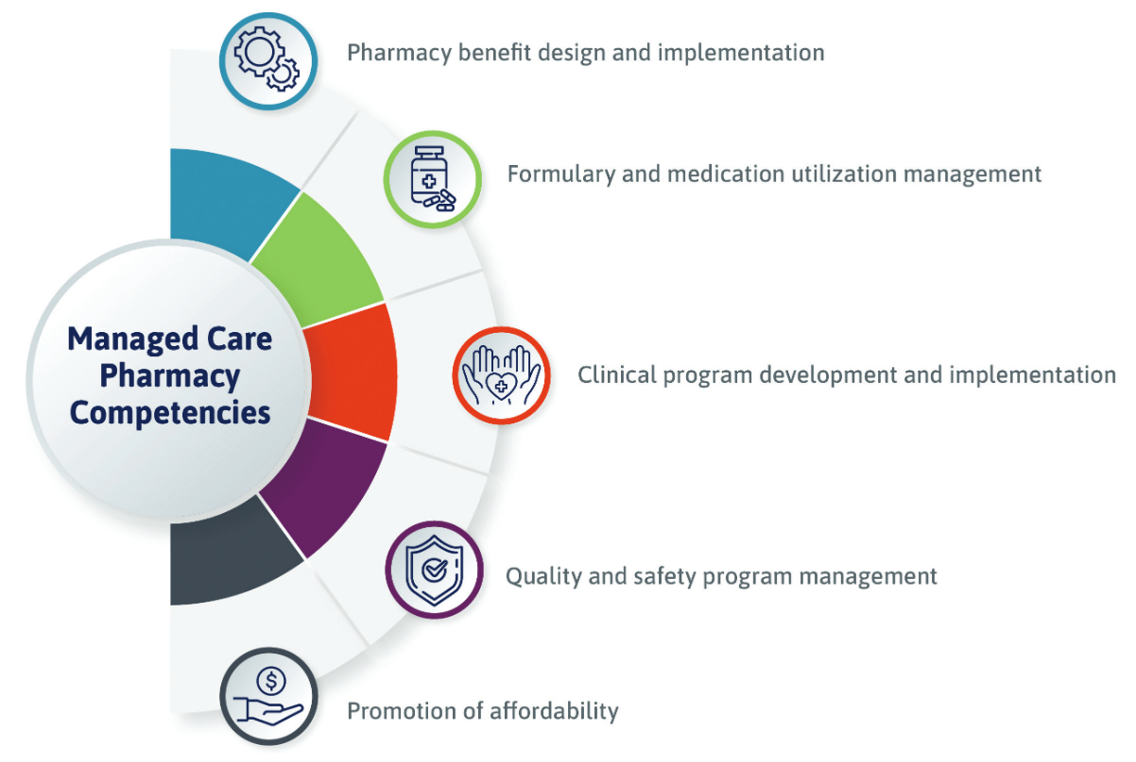
Covered Pharmacy Benefit
Many MCOs offer a prescription drug plan as part of healthcare benefits
Prescription medications are essential in preventing and treating a wide variety of acute and chronic conditions
MCOs employ many common competencies to achieve patient and population health goals through the appropriate use of medications.
Notes:
Prior authorization: Patient and/or prescriber must contact plan before certain prescriptions can be filled. Determined by the plans
Quantity limits: Limits on how much medication may be obtained at a time
Step therapy: Plans may require patients to try lower cost, or similar drugs before covering prescribed drug

Slide 10
References
Happe LE, Edgar BS. A primer on managed care pharmacy. JMCP. 2023;29(12):1371-1376. doi:10.18553/jmcp.2023.29.12.1371
Burns LR. The U.S. Healthcare Ecosystem: Payers, Providers, Producers. 1st ed. McGraw Hill Medical; 2021.
Navarro, Robert P. Managed Care Pharmacy Practice. 2nd ed. Sudbury, MA: Jones and Bartlett, 2009.
U.S. Department of Health and Human Services. About the ACA. Accessed on: February 22, 2020. https://www.hhs.gov/healthcare/about-the-aca/index.html.

Slide 11
Mission & Vision
To improve patient health by ensuring access to
high-quality, cost-effective medications and other therapies.

Slide 12
Thank you to AMCP Schools of Pharmacy Relations Committee (SOPRC) members for reviewing this presentation for 2024

