Slide 1
Health Disparities: Role of Managed Care Pharmacy

Slide 2
Objectives
Identify the gaps in medication use due to health disparities and the role health plans can play in bridging the gaps.
List challenges and opportunities in collecting health disparities data and using the information for payment changes.
Through case examples, summarize strategies health plans use to facilitate data collection and payment changes to address health disparities.

Slide 3
Key Take Aways
Health plans play an essential role in closing the gaps due to health disparities
Foundational education is needed to understand the types of disparities that exist
Having health equity data can lead to change and targeted interventions
There are innovative ways plans are paying for health equity interventions
AMCP has resources to help close health disparities gaps in medication use and access

Slide 4
Definitions
The state in which all individuals have the opportunity to achieve their full health potential
Health Equity
The conditions in which individuals are born, grow, work, live, and age, including economic, political, environmental, cultural, and social policies that positively or negatively impact health
The preventable differences in health status (disease burden, access to care, outcomes) among individuals and communities that are related to social and demographic factors such as race, gender, income, or geographic region
Health Disparities
Social Determinants
Healthy Communities
The individual-level, adverse social conditions that increase the likelihood of poor health outcomes
Social Risks
Notes:
Means that everyone has a fair & just opportunity to be as healthy as possible. This requires removing obstacles to health such as poverty, discrimination, and their consequences, including powerlessness and lack of access to good jobs with fair pay, quality education and housing, safe environments, and health care.

Slide 5
Pharmacoequity
Ensuring all individuals, regardless of race and ethnicity, socioeconomic status, or availability of resources, have access to the highest-quality medications required to manage their health needs.

Slide 6
Who does it effect?
Black families are up to 4.6x more likely than white families to live in areas of concentrated poverty rate
Black participants make up <5% of cancer medication clinical trials
Among US adults, 10% skipped medications doses to save money
Latinos are 22% more likely than whites to not be treated with PrEP among high-risk gay and bisexual men
Notes:
Source: The Economic impact of closing the racial wealth gap, McKinsey and Company

Slide 7
Role of Managed Care Pharmacy
Data | Diversity in clinical trial enrollment, strengthen trial designs to better detect possible heterogeneity in patient response, and expand subgroup reporting Augment data available within health care delivery systems by, for instance, more thorough and efficient collection of patient demographic information into medical records Recognize that biases may be unintentionally built into current algorithms and artificial intelligence platforms
Formulary Process | Incorporate robust diversity data into drug monograph tools used in formulary development Provide annual equity training for Pharmacy & Therapeutics committee members Add committee representation that reflects an organization’s minority membership or a member with expertise in equity Create a subcommittee to evaluate equity in formulary decisions
Benefit Offerings | Acknowledge and consider racial disparities in initial benefit design process Consider variable cost-sharing and premiums, such as on a sliding scale based on income Offer a preventive medication benefit with a lowered or zero-dollar copay Adjust cost-sharing models in disease states where minority or other at-risk populations are disproportionally affected
Findings from AMCP Partnership Forum, March 2021
Notes:
Findings from AMCP Partnership Forum from March 2021
With this foundation in mind, participants highlighted a set of priority considerations to advance equity in formulary and benefit design. Among the most important of these is the need to fill existing gaps in data. This is especially true for both clinical trials and real-world evidence, with calls to increase diversity in study enrollment, strengthen trial designs to better detect possible heterogeneity in patient response, and expand subgroup reporting to inform more nuanced formulary evidence reviews. Considerations were also raised with respect to augmenting the data available within health care delivery systems by, for instance, more thorough and efficient collection of patient demographic information into medical records; although it was acknowledged that there is a need to balance collection and utilization of that data with patient privacy concerns and for an awareness that biases may be unintentionally built into current algorithms and artificial intelligence platforms. Additionally, participants suggested that having more robust health outcomes data by racial and ethnic group available and incorporating that data into drug monograph tools used in formulary development – for example, the AMCP Format or monograph templates – would support addressing diversity and equity. Further suggestions to improve this process included providing annual equity training for pharmacy & therapeutics (P&T) committee members, having committee representation that reflects an organization’s minority membership, adding a member with expertise in equity, creating a subcommittee to evaluate equity in formulary decisions, and engaging patient voices from disadvantaged groups to share their experiences and feedback.

Slide 8
Role of Managed Care Pharmacy
Patient Access | Consider benefit flexibility to improve access Utilize automated tools, such as real-time benefit checks and electronic prior authorization, to assist those with less time or fewer resources to navigate benefits and utilization management Expand access to the care delivery network, such as by relocating clinics or pharmacies onto public transportation lines Enhance care coordination through more systematic engagement of pharmacists, community partners, and health navigators Develop patient outreach programs with simplified materials to improve health and health insurance literacy
Findings from AMCP Partnership Forum, March 2021
Notes:
Participants also saw value in evaluating other existing systems through a lens of increasing equity (or acknowledging patient differences), driving a shift from the standard of equality (or treating all patients the same) that they suggested is primarily in place today. They indicated this could include involving partners, such as consultants and other stakeholders to update benefit designs and allow benefit flexibility, particularly considering the evolving landscape of higher-cost specialty medications, or populations for whom some medications may provide different outcomes or who might be disproportionately affected by certain conditions. Specific solutions introduced include allowing variable cost-sharing and premiums, such as on a sliding scale based on income; offering a preventive medication benefit with a lowered or zero-dollar copay; and adjusting cost-sharing models in disease states where minority or other at-risk populations are disproportionally affected. A system evaluation could also result in identifying opportunities for new or revised programs around payment incentives or disincentives for health care providers that participate in equity efforts; this could enhance accountability for ensuring these efforts translate into greater equity.
However, a crucial consideration that participants emphasized was the need for any system evaluation to consider how patients access and interact with the system and to implement strategies to lessen advantaging or disadvantaging any particular group. An example offered was to encourage the use of automated tools such as real-time benefit checks and electronic prior authorization whenever possible to assist those with less time or fewer resources to navigate benefits and utilization management. It could also include expanding access to the care delivery network such as by relocating clinics or pharmacies onto public transportation lines.
Participants recognized that successful efforts to improve equity in the provision of health care must be committed to patient-centered care. Engaging in both broad and local activities to build trust and increase access in minority populations is one timely example provided, especially, it was noted by participants, as health care professionals seek to increase adoption of COVID-19 vaccinations. It was also seen as important to enhance care coordination through more systematic engagement of pharmacists, community partners, and health navigators, which could further foster trust and could also be a way to assess patient-specific social determinants of health accurately, and efficiently address persistent access barriers, whether they be socioeconomic factors, limited access to health care facilities, interpersonal and/or systemic racism, or others. Additional examples included enhanced diversity and inclusion in the health care workforce, developing patient outreach programs with simplified materials to improve health and health insurance literacy and sharing best practices and case studies in peer-reviewed journals, such as The Journal of Managed Care & Specialty Pharmacy (JMCP).

Slide 9
Education
Health Equity
Results
Cultural and linguistic training
Resources
Notes:
Types of education: cultural competency, general health equity training, specific training for job (asking questions, working with others, etc)

Slide 10
Types of education
Education and data reporting are foundational to development and measuring impact
Education of leadership team and associates to increase awareness, knowledge, and advocates
Cultural competency
Implicit bias
Inequities in health care
Work with universities to develop educational program
How One Health Plan Reduced Disparities in Medication Adherence. Harvard Business Review, 2022
Notes:
Many organizations have education
https://hbr.org/2022/07/how-one-health-plan-reduced-disparities-in-medication-adherence: SCAN work with University: At an education program designed by the Western Region Public Health Training Center at the University of Arizona’s Mel and Enid Zuckerman College of Public Health, the pharmacists and navigators learned how to better relate to the Black and Hispanic members they would be speaking to. For example, the University of Arizona’s courses emphasize “cultural humility.” Participants are encouraged to reflect on their own cultural biases and are equipped with tools and skills to listen and adapt to each patient’s unique circumstances and situation.
Trained in this new way, the pharmacists and care navigators reached out directly to members who were of the same race or ethnicity in order to assess barriers to adherence and design bespoke solutions for each member.

Slide 11
Data collecting is important
Race, ethnicity, language
Social Determines of Health
Geography
Sexual Orientation and Gender Identification
Disabilities
Reduce gaps in care

Slide 12
Where does the data come from?
Direct Data
Information collected directly from the patient
“Gold Standard” for health equity data
Best use for focused interventions
Indirect Data
Information inferred from other sources
Examples of sources:
Zip code
Census data
Best use for population level analysis
Notes:
Census data: income, education, language, name– talk about AI to compute this data and overlay with other types of data to make inferences

Slide 13
Barriers to collecting data
Data standardization
Provider participation
Internal readiness
Data transfer between systems
Use and analyze data
Member trust
Sensitivity and implications of collecting data
Stigma

Slide 14
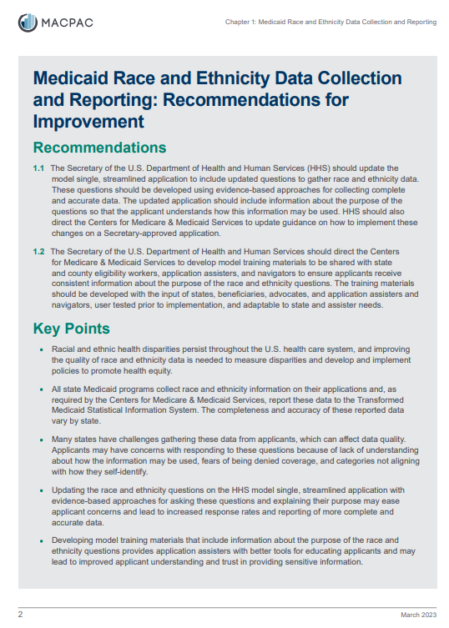
Examples of data standards
Centers for Disease Control & Prevention
Medicaid and CHIP Payment and Access Commission
National Academy of Science, Engineering, and Medicine
Office of Management and Budget
The Fenway Institute resources
The United States Department of Health and Human Services

Slide 15
Data collection
Identify Data Gaps
Recognize Limitations
Appreciate Sensitivity and Stigma
Foster Member Trust
Get Started!
Notes:
Health disparities are a major concern with far-reaching impacts on individual’s lives and health status. Improving data collection approaches and reporting strategies is an integral component to addressing disparities in pursuing health equity.
Identifying gaps in data availability and access as well as innovative strategies to address these challenges is critical to moving the health disparities work forward as a key priority area in HC
Health plans must recognize the challenges they are confronted with for collecting sensitive member information (e.g., RELD, SDOH, & SOGI), including necessary infrastructure updates
When developing strategies to address disparities, utilize established standards when collecting key member demographic and health-related social needs
Recognize the sensitivity of personal member information and foster trust with members regarding data protection and intended uses to facilitate optional data sharing
Continuously review the data and normalize addressing disparity concerns at P&T and other stakeholder meetings
So let's get started to ensure health equity becomes a reality!
Thank you!

Slide 16
Case studies
Blue Shield of California: the 80 Mapping Tool
Community Health Advocate
Database and tools based on neighborhoods
Addressing the root causes of the health inequities patients encounter
Evernorth: Community Pharmacy Pilot
Pharmacists
Geography challenges and no diabetologist
Through pharmacist counseling to decrease A1c
Notes:
Evernorth – podcast: https://www.evernorth.com/articles/social-vulnerability-index-helps-identify-social-determinants-of-health?mkt_tok=ODA5LVZHRy04MzYAAAGIY2-rWPGUtuvjQlK2ezJyYJwsCn5tTa3zzLDblfeNohNma2a6BDSMspGStQTkVmE0Lt4lNcVoFbpGsQYlMRfGGc6KxAN3U2TO8yX3n1Mk0Es6eg

Slide 17
Case studies
Elevance Health:
Added a non-binary birth-sex selection “U” to their membership and electronic enrollment process
“U” does not denote the member’s preference but signals that the gender preference is unknown to the plan
Humana
Collecting and incorporating three types of health-related social needs data to close the SDOH gaps for their members
Use self-reported, derived, and inferred data via validated assessment tool
Data is standardized to identify the health care needs of their members
Notes:
Humana: The self-reported data is collected using a validated assessment tool. The derived data is obtained through predictive modeling and natural language processing. The inferred data comes from community-level data collected from government agencies.

Slide 18
How do you pay for health equity?
Provider payment
Offering social needs
Incentivizing payments to cover disparity populations
Value-based agreements
Result stratification
Payer incentivization
Internal incentivization to close gaps in disparities
Adherence measures
Notes:
AG call from last month
VBA – payer, pharmacies, providers could be involved
Payer incentivization – incentivize all areas involved

Slide 19
Change using value-based contracting
Massachusetts Blue Cross Blue Shield
Value-based payment contracts
Bridge gaps due to race
Incorporate equity measures into contracts and payment programs with health systems and providers
Focus on measuring and regarding equity in care in cancer screening, blood pressure control, and diabetes care
Different set of measures based on scale and diversity of population and baseline inequity
Notes:
https://www.beckerspayer.com/contracting/bcbs-massachusetts-adds-health-equity-to-contracts-with-health-systems.html
https://www.fiercehealthcare.com/payers/blue-cross-blue-shield-ma-clinches-value-based-contracts-equity-metrics

Slide 20
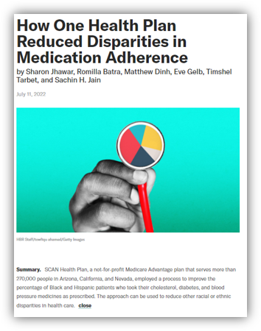
Change using STAR Ratings
SCAN Health
STAR Ratings tied to medication adherence
Black and Latinx members
Diabetes, hypertension, and high cholesterol
Ethnographic interviews to identify beliefs and other barriers for adherence
Notes:
https://www.managedhealthcareexecutive.com/view/amcp-nexus-2021-how-scan-turned-healthcare-disparity-talk-into-action

Slide 21
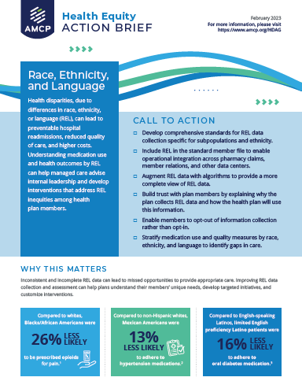
AMCP Resources
Diversity, Equity, and Inclusion Glossary
Health Equity Action Briefs
Education
National meetings
Webinars
Affiliate meetings
AMCP Summit: Health Disparities
December 2023
AMCP Collaborate

Slide 22
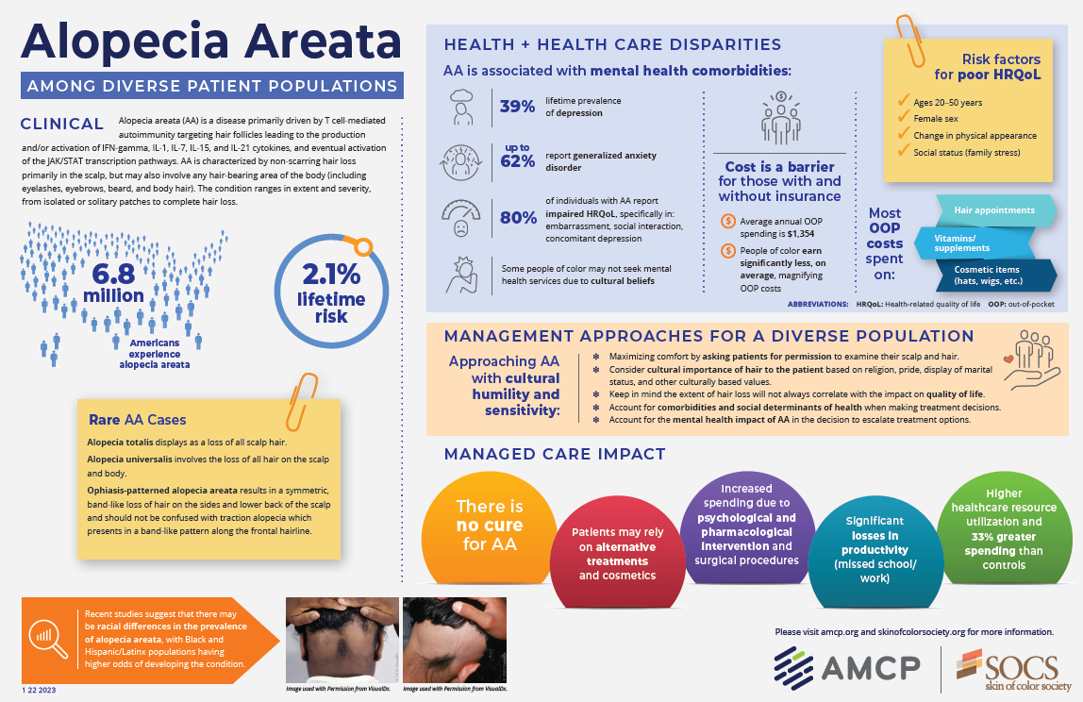
What can you do?
Education
Overall health equity
Current standards to collect data
Current accreditation standards
Data to advance health equity
Collection
Appropriate use of data
Innovation is key

Slide 23
Key Take Aways
Health plans play an essential role in closing the gaps due to health disparities
Foundational education is needed to understand the types of disparities that exist
Having health equity data can lead to change and targeted interventions
There are innovative ways plans are paying for health equity interventions
AMCP has resources to help close health disparities gaps in medication use and access

Slide 24
Additional Resources
AMCP Resource Center: Health Disparities
AMCP Health Disparities Advisory Group
Blog post: The Challenge of Health Equity in Pharmacy

Slide 25
Thank You
@AMCPorg
@AMCPorg
@AMCPorg
AMCP

