Slide 1
HEDIS & HEDIS Measures
Created by the School of Pharmacy Relations Committee for AMCP
Updated: March 2024

Slide 2
Objectives
Understand the purpose of HEDIS measures within health care
Demonstrate how HEDIS measures are developed through examples
Examine strategies for applying HEDIS measures
Identify ways to get involved in the HEDIS development process

Slide 3
National Committee for Quality Assurance (NCQA)
The National Committee for Quality Assurance (NCQA) was established in 1990 as a non-profit organization dedicated to improving healthcare quality through accreditation and certification
Employers now require or strongly encourage NCQA Accreditation from health plans
NCQA Health Plan Accreditation includes
Clinical Performance: Healthcare Effectiveness Data and Information Set (HEDIS®)
Consumer Experience: Member Satisfaction through Consumer Assessment of Health Providers and Systems (CAHPS®) Survey
Notes:
The National committee for quality assurance is a private, non-profit organization that works to improve healthcare quality. NCQA offers several accreditations and certifications to health plans, accountable care organizations (ACOs), patient centered medical homes (PCMH), wellness and health promotion, and disease management recognition programs.
HEDIS and CAHPs surveys are taken into consideration for plans looking achieve a high level of accreditation

Slide 4
Healthcare Effectiveness Data and Information Set (HEDIS)
Developed by NCQA, HEDIS is a standardized performance measurement of health plans
227 million people are enrolled in health plans that report out HEDIS measures
Health plans seeking NCQA accreditation are assessed by the performance of HEDIS measures
Applicable to Commercial, Medicare, and Medicaid
Health plan results on HEDIS measures are made publicly available
HEDIS
may be used by
Patients
Government
Agencies
Employers
Notes:
HEDIS measures allow an “apples-to-apples” comparison amongst different health plans
Health plans include health maintenance organizations (HMO), point of service (POS) organizations, and preferred provider organizations (PPO)
NCQA. HEDIS Measures and Technical Resources. Accessed from https://www.ncqa.org/hedis/measures/

Slide 5
Healthcare Effectiveness Data and Information Set (HEDIS)
Data categories for approximately 90 HEDIS measures evaluate six care domains:
Effectiveness of care
Access/availability of care
Experience of care
Utilization and Risk Adjusted Utilization
Health Plan Descriptive Information
Measures Collected Using Electronic Clinical Data Systems
Notes:
NCQA. HEDIS and Performance Measurement. Accessed from https://www.ncqa.org/hedis/

Slide 6
HEDIS Measure Development
HEDIS measures are continuously reviewed based on published guidelines and scientific evidence
Feedback is gathered from multi-stakeholder advisory panels that complete the development of measures. Examples include
NCQA Committee on Performance Measurement
Measurement Advisory Panels
HEDIS Expert Panels
HEDIS Technical Measurement Advisory Panel
Consumer Advisory Panel
Notes:
- NCQA Committee on Performance Measurement, a diverse panel of independent scientists and representatives from health plans, consumers, federal policymakers, purchasers and clinicians, oversees the evolution of the measurement set
- Measurement Advisory Panels provide clinical and technical knowledge required to develop the measures
-HEDIS Expert Panels and the Technical Measurement Advisory Panel focuses on methodology and providing feedback on new and existing measures

Slide 7
Healthcare Effectiveness Data and Information Set (HEDIS)
Rates for clinical measures can be reported as
Prevention Measure: Proportion of eligible members who received preventive services
Treatment Measure: Proportion of eligible members who received recommended care for certain conditions

Slide 8
Healthcare Effectiveness Data and Information Set (HEDIS)
Rates for clinical measures can be reported as
Prevention Measure: Proportion of eligible members who received preventive services
Examples
Childhood Immunization Status (CIS)
Flu Vaccinations for Adults Ages 18 – 64 (FVA)
Breast Cancer Screening (BCS)
Controlling High Blood Pressure (CBP)
Notes:
NCQA. HEDIS Measures and Technical Resources. Accessed from https://www.ncqa.org/hedis/measures/

Slide 9
Healthcare Effectiveness Data and Information Set (HEDIS)
Rates for clinical measures can be reported as
Treatment Measure: Proportion of eligible members who received recommended care for certain conditions
Examples
Pharmacotherapy Management of COPD Exacerbation (PCE)
Pharmacotherapy for Opioid Use Disorder (POD)
Osteoporosis Testing and Management in Older Women (OMW)
Notes:
NCQA. HEDIS Measures and Technical Resources. Accessed from https://www.ncqa.org/hedis/measures/

Slide 10
Measure Example: Statin Therapy for Patients With Cardiovascular Disease and Diabetes (SPC/SPD)
Moderate-to-High intensity statin are recommended for those with established clinical ASCVD
The treatment measure Statin Therapy for Patients with Cardiovascular Disease (SPC) assesses
Males 21–75 years of age and females 40–75 years of age, AND
Have clinical ASCVD, AND
Received and adhered to statin therapy
Notes:
NCQA. Statin Therapy for Patients With Cardiovascular Disease and Diabetes (SPC/SPD). Accessed From https://www.ncqa.org/hedis/measures/statin-therapy-for-patients-with-cardiovascular-disease-and-diabetes/

Slide 11
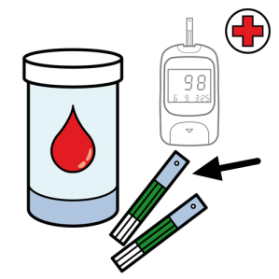
Measure Example: Statin Therapy for Patients With Cardiovascular Disease and Diabetes (SPC/SPD)
Statins are recommended for the primary prevention of cardiovascular disease for persons with diabetes
The treatment measure Statin Therapy for Patients with Diabetes (SPD) assesses
Adults 40-75 years of age who have diabetes, AND
Do not have clinical ASCVD, AND
Received and adhered to statin therapy
Notes:
NCQA. Statin Therapy for Patients With Cardiovascular Disease and Diabetes (SPC/SPD). Accessed from: https://www.ncqa.org/hedis/measures/statin-therapy-for-patients-with-cardiovascular-disease-and-diabetes/

Slide 12
Measure Example: Antidepressant Medication Management (AMM)
Appropriate medication management and monitoring of depression can improve a person’s daily functioning, well-being, and potentially reduce risk of suicide
Potential to alleviate the overall economic burden of inadequate medication management
The AMM treatment measure assesses people
18 years and older, AND
Diagnosed with major depression, AND
Newly prescribed medication and remained on therapy
Assessment reports out two rates
Effective Acute Phase Treatment: People who remained on an antidepressant for at least 84 days (12 weeks)
Effective Continuous Phase Treatment: People who remained on antidepressant medication for at least 180 days (6 months)
84
180
Notes:
NCQA. Antidepressant Medication Management (AMM). Accessed from https://www.ncqa.org/hedis/measures/antidepressant-medication-management/

Slide 13
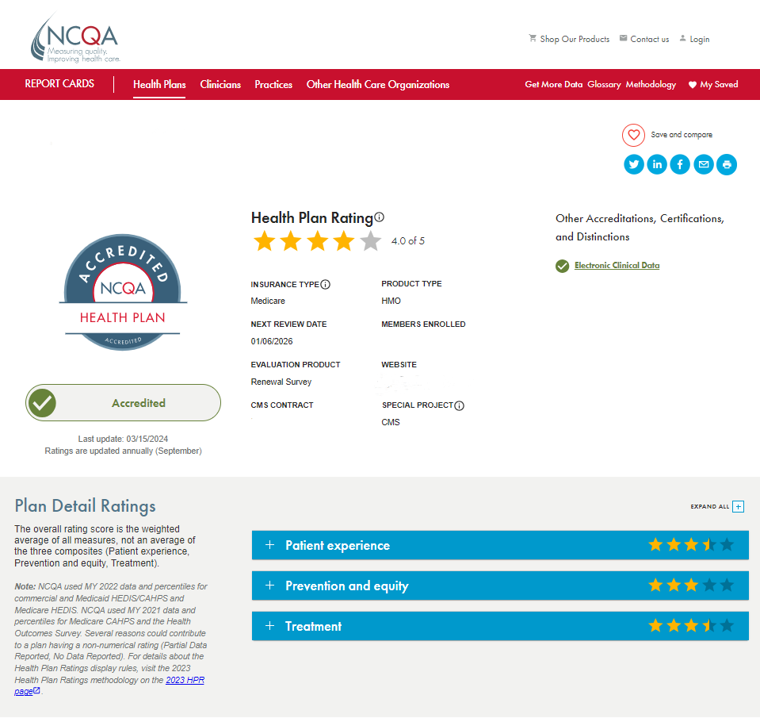
NCQA Health Plan Report Cards
Points are awarded based on measure-specific thresholds
NCQA’s Health Insurance Plan Report Cards list health insurance plans (commercial, Medicare, Medicaid, and Exchange) based on their combined HEDIS and CAHPS scores and NCQA Accreditation status
Publicly available on NCQA website: https://reportcards.ncqa.org/health-plans
Information can be used during open enrollment by patients, employers, and government agencies
Notes:
NCQA. Report Cards – Health Plans. Last updated 03/15/2024. Accessed from https://reportcards.ncqa.org/health-plans

Slide 14
Strategies to Meet HEDIS Measures
Educate and promote HEDIS measures and goals within the health plan and to providers
Develop strategies to meet measures through clinical, drug utilization, and monitoring programs
Encourage advancements in technology to help integrate patient and provider data

Slide 15
Conclusion
HEDIS consists of preventative and treatment measures based on clinical guidelines and evidence
These measures provide a uniform “apples-to-apples” comparison of care provided across health plans
Information can be used by patients, employers, and government agencies

Slide 16
Helpful Resources
Kongstvedt PR. Health Insurance and Managed Care: What They Are and How They Work. 5th Edition. Jones & Bartlett Learning: Burlington, MA; 2020.
Navarro RP, et al. Managed Care Pharmacy Practice. 2nd edition. Jones and Bartlett Publishers: Sudbury, MA; 2009.
NCQA: https://www.ncqa.org/hedis/measuresttp://www.ncqa.org/

Slide 17
Mission & Vision
To improve patient health by ensuring access to
high-quality, cost-effective medications and other therapies.

