Slide 1
Academy of Managed Care Pharmacy
Wilkes University Chapter
Student Leadership Academy Presentation
Cole Wenner: Immediate Past President, c/o 2024
Nik Norman: President, c/o 2025

Slide 2
2022-2023 Chapter Highlights
Event 1: Medicare Made Easy
Event 3: Prior Authorization Competition
Event 2: The Great Managed Care Escape Room

Slide 3
Event #1: Medicare Made Easy
Medicare consultations led by students
Students had the opportunity to aid members of our community choose their Medicare plans
Help navigate medicare.gov
Connections made with community members

Slide 4
Event #2: The Great Managed Care Escape Room
A unique introduction to managed care
An exciting, interactive way to promote knowledge and interest in managed care/AMCP
Managed Care Principles
Terminology
AMCP Resources

Slide 5
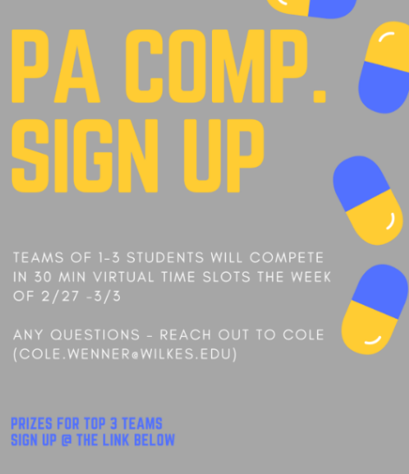
Event #3: Prior Authorization Competition
Competition among Wilkes University and UMB students
Opportunity to utilize managed care knowledge
Real world scenarios for which teams approve/deny and rationalize their decision
Feedback provided on decisions
Incentives provided to winners and great perspective on managed care and PA utilization tool

Slide 6
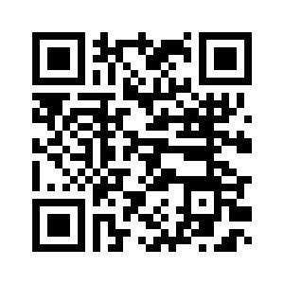
Connect with us!
Instagram: @wilkesamcp

Slide 7
Thank you on behalf of Wilkes University AMCP!

