Slide 1
Academy of Managed Care Pharmacy
University of Connecticut Chapter Student Leadership Academy Presentation Ryan Shan UConn AMCP President Class of 2026
Notes:
School Size, etc.

Slide 2
01
Introductions
02
Events Overview
03
Event Organization & Tips
04
Connect with Us
Notes:
Discussing 3 events
Takeaways and what we are doing better

Slide 3
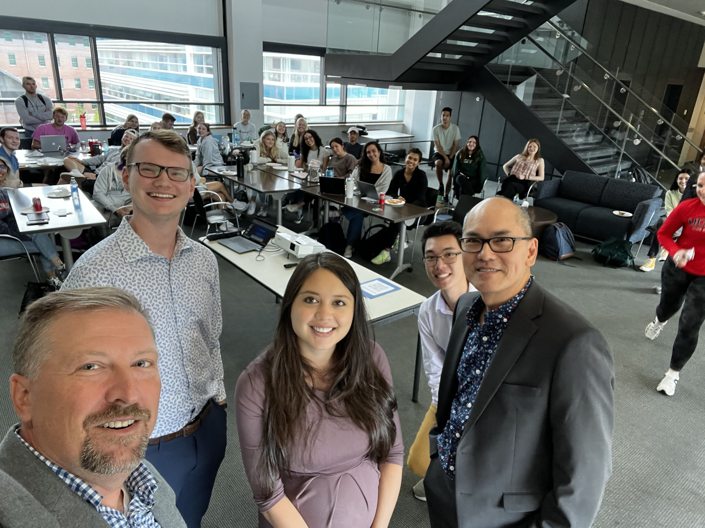
Event #1 | Lunch & Learn

Slide 4
Membership Drive
2 Guest speakers with Managed Care Experience Free Lunch for Students Chapter Recruiting
Managed Care Education
65
N/A
Event Synopsis
Outcomes
Attendees
Collaboration
Notes:
Also just did another this year ~ 40 – 50 attendees

Slide 5
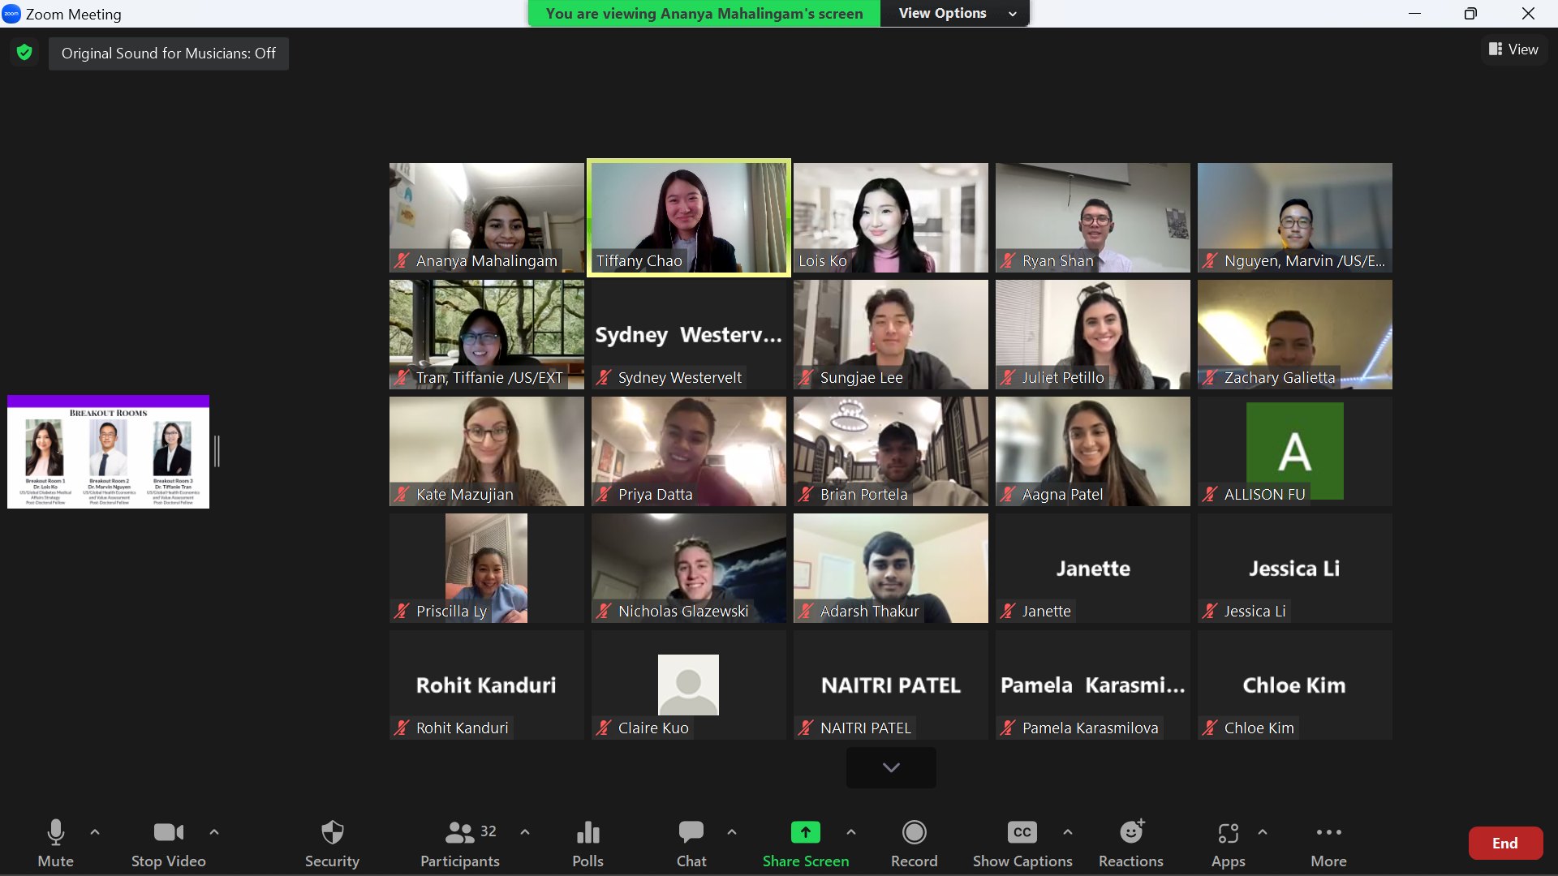
Event #2 | Sanofi Virtual Site Visit

Slide 6
Collaboration with Rutgers
3 Sanofi Fellows as guest speakers Zoom Break out rooms Trivia
Networking
MC Careers in Industry
39
Rutgers / Sanofi
Event Synopsis
Outcomes
Attendees
Collaboration

Slide 7
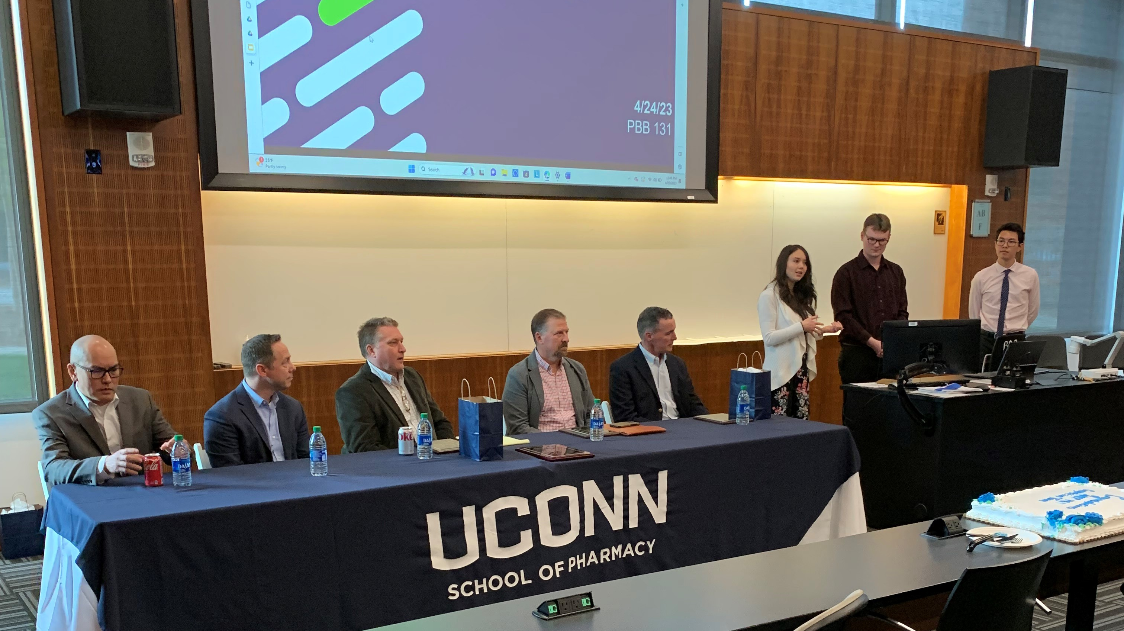
Event #3 | End of Year Celebration

Slide 8
Managed Care Education
Managed Care Panel Free Lunch and Cake P&T Competition Plaque Presentation Guided tour of UConn Campus for Alumni
Celebration
Officer Turnover
36
UConn School of Pharmacy
Event Synopsis
Outcomes
Attendees
Collaboration

Slide 9
What We Wish We Knew
Start Planning in Summer
Collaborating with other chapters
Involving school faculty and administration
Social Media
Chapter Group Chat

Slide 10
Connect with Us
uconnamcp@gmail.com
@uconnamcp

