Slide 1
AMCP Annual 2023
Chapter Leadership Academy Presentation
Kevin H. Li
Jonathan Luong
Tiffany Tran
Vida Joy Ordonez
Notes:
COTY Packet Submission: https://drive.google.com/drive/u/3/folders/1S-h7kXniqGTRMImxwaFinrqlVh1zn8uC
10 min presentation
Proposed Timeline
First Draft: Feb 17th
Meeting: Feb 16th
Deadline: Mar 3rd

Slide 2
Agenda
Introductions
Events
Tips for Organizing and Planning
Tips for Advertising and Promoting
1
2
3
4
Notes:
All

Slide 3
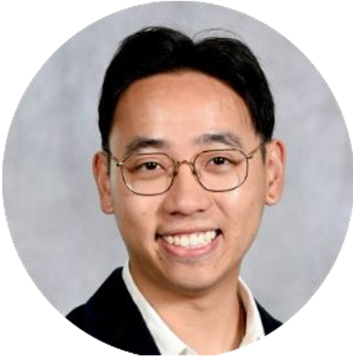
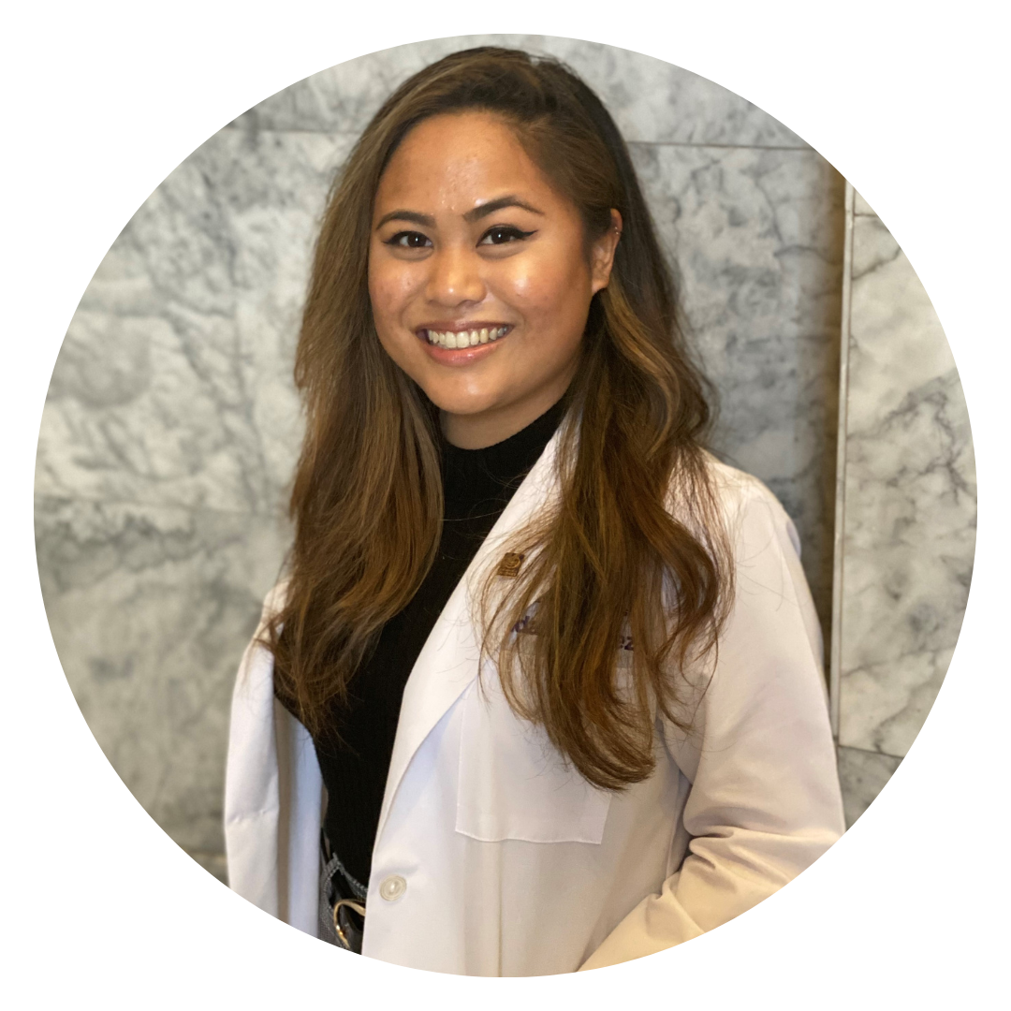
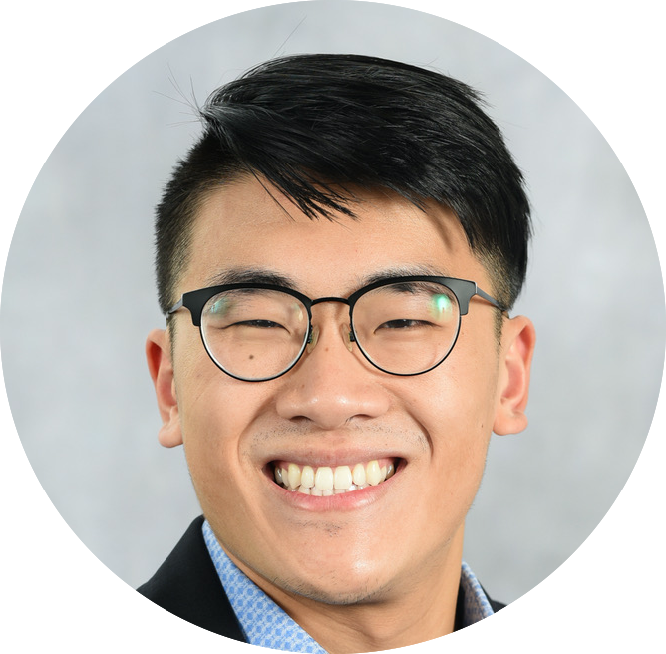
Introductions
Vida Ordonez
Historian
Class of 2024
Kevin Li
Immediate Past President
Class of 2024
Jonathan Luong
President
Class of 2025
Tiffany Tran
Treasurer/Assistant P&T Director
Past Director of Public Relations
Class of 2025
Notes:
All

Slide 4
Event #1 | Workshop on Data Equity Issues in Quantifying Racism, Race, and Ethnicity
Collaboration | UW DEIC, UW ISPOR, UW GPSS
Planning | 1 year / In-person & Zoom
Attendees | 60
Event Synopsis | Discussion on research focus on racism in data and study design, and considerations for improving equity in research methods
Outcomes | Improve cultural competence in racial inequity in study design Identify and quantify bias in clinical data to improve health equity in future research
Notes:
Jonathan

Slide 5
Event #2 | UW and OHSU Managed Care Roundtable
Collaboration | OSU/OHSU AMCP Student Chapter
Planning | 3 months / Zoom
Attendees | 43
Event Synopsis | Panel of pharmacists and pharmacy students working in a variety of managed care roles Virtual breakout rooms with icebreaker and networking opportunities
Outcomes | Provide opportunity for students to connect and network with managed care pharmacists working in different roles Solicit career advice and initiate mentorships for future guidance
Notes:
Kevin

Slide 6
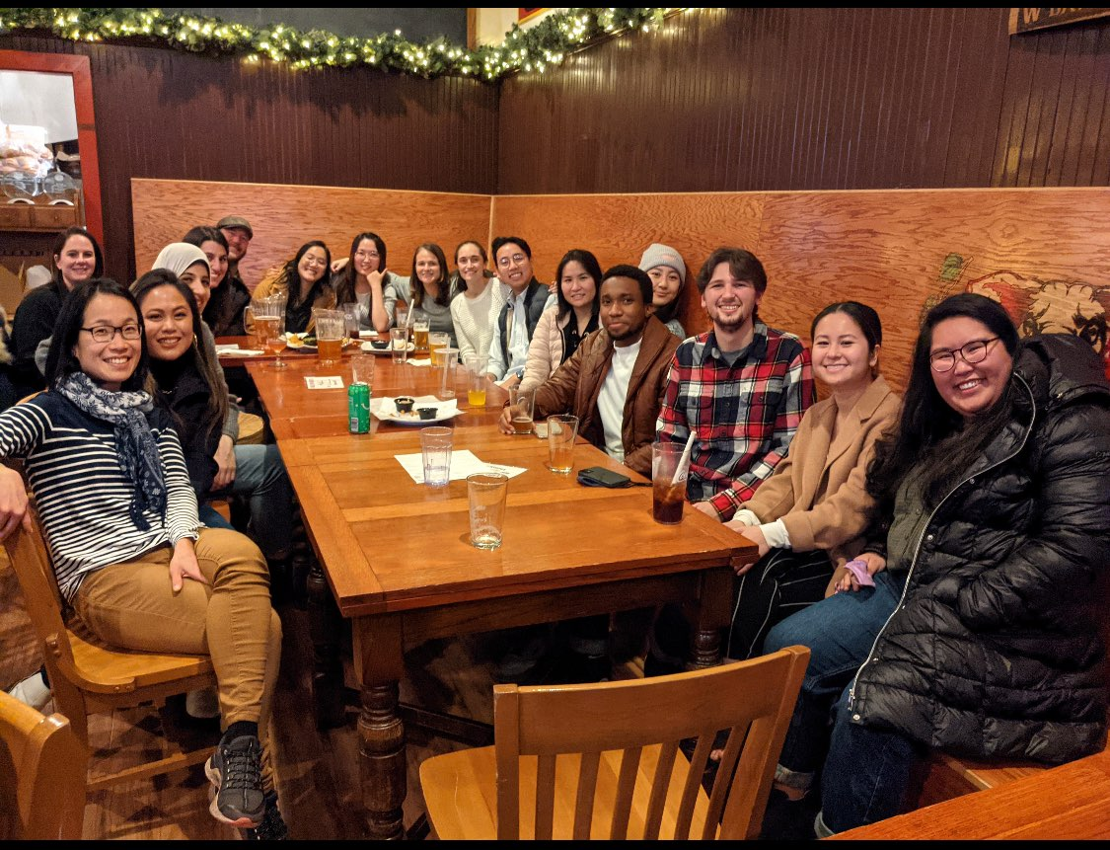
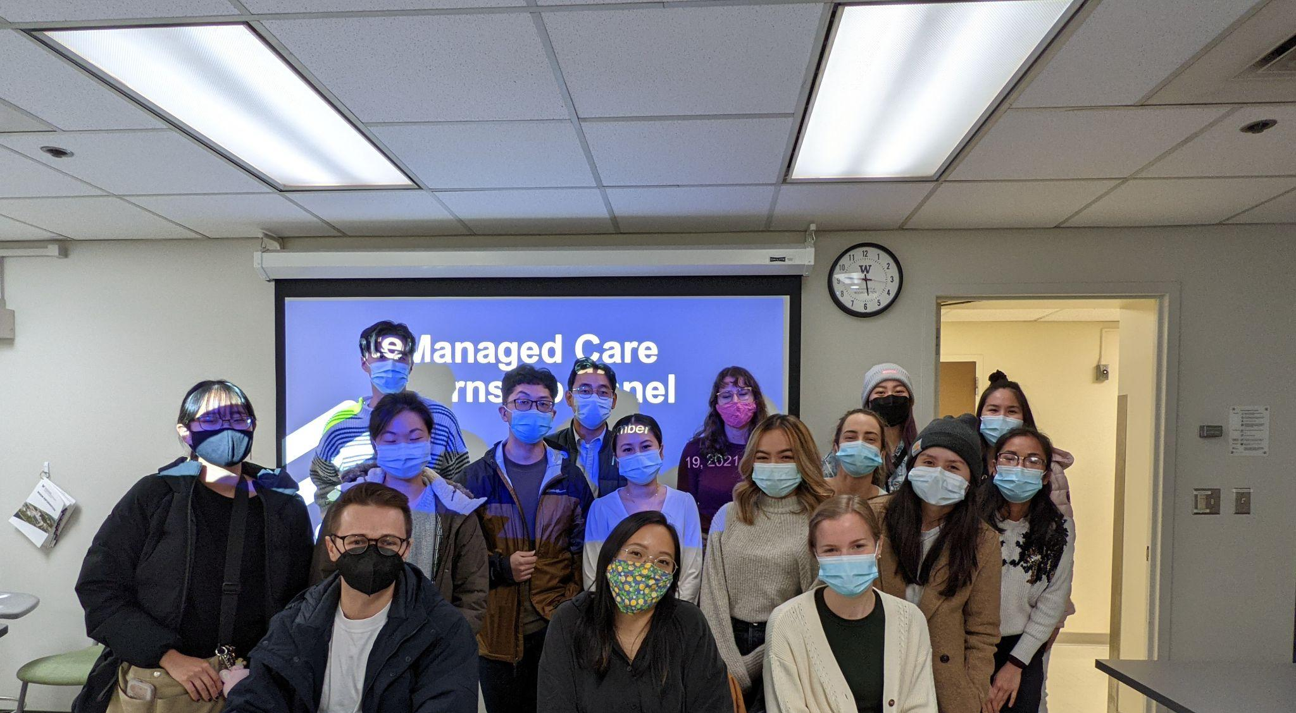
Event #3 | UW AMCP/ISPOR Managed Care Internship Panel and Social
Collaboration | UW ISPOR
Planning | 2 months / In-person
Attendees | 30
Event Synopsis | Panel of 3 UW pharmacy students who recently completed AMCP Foundation summer internships Post-panel happy hour social
Outcomes | Provide information regarding internship opportunities in managed care for student pharmacists Networking opportunities with faculty, panelists, ISPOR students
Notes:
Vida

Slide 7
Tips for Organizing and Planning
Scheduling | Programming | Preparation
Gather all exam schedules for all years Book rooms early for in-person events For in person events, schedule during lunch break and provide lunch or snacks to help gain attendance | Have board meeting prior to start of quarter to start strategic planning Be intentional, set a goal and purpose of each event Identify student interests and knowledge gaps | Send panelists or guest speakers the event outline and preset questions to help them prepare their presentation slides and discussion Create materials to help students actively engage during the event. e.g., Sent networking tips handout prior to panel Bring a buddy to events / soft outreach
Notes:
Jonathan + Kevin

Slide 8
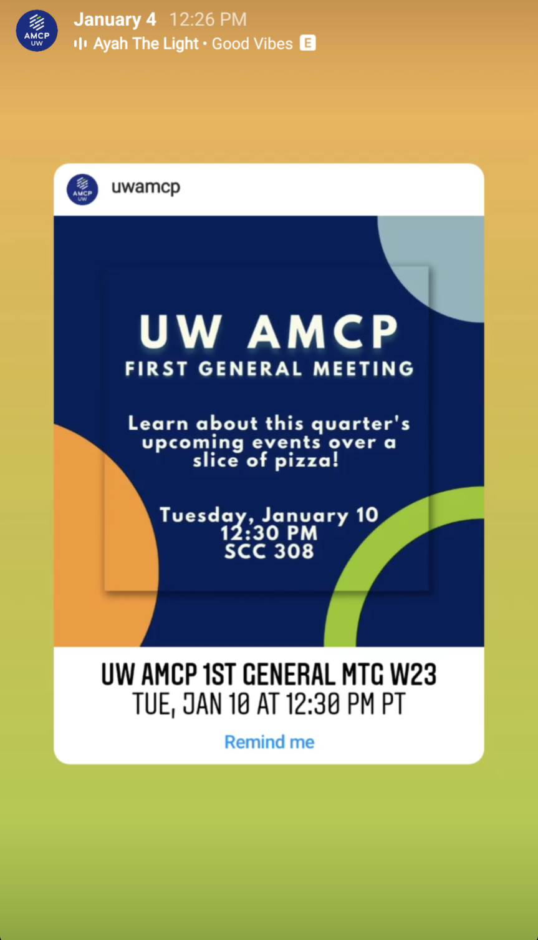
Tips for Advertising and Promoting
First initiate email and IG post to class listserv 1-2 weeks before event
Post to class FB and class Discord 2-3 days after initial email
Follow-up and reminder email and Discord announcement 1-3 days before the event
Repost UW AMCP IG post to personal story
Events open to the public
Post on AMCP Collaborate
Post on LinkedIn
Add a reminder link in the posts so students can receive auto reminders of the event dates and times
Post event recaps on social media to improve engagement and leverage momentum following events
Notes:
Vida + Tiffany
Vida - quarterly newsletter

Slide 9
Connect with us
uwamcp@gmail.com
@uwamcp
Notes:
Kevin

Slide 10
Mission
To improve patient health by ensuring access to high-quality, cost-effective medications and other therapies.
Notes:
Kevin

