Slide 1
Academy of Managed Care Pharmacy
University of Maryland Chapter
Chaper Leadership Academy Presentation
Chenchu Vignesh Pernati
UMB AMCP President
Class of 2024

Slide 2
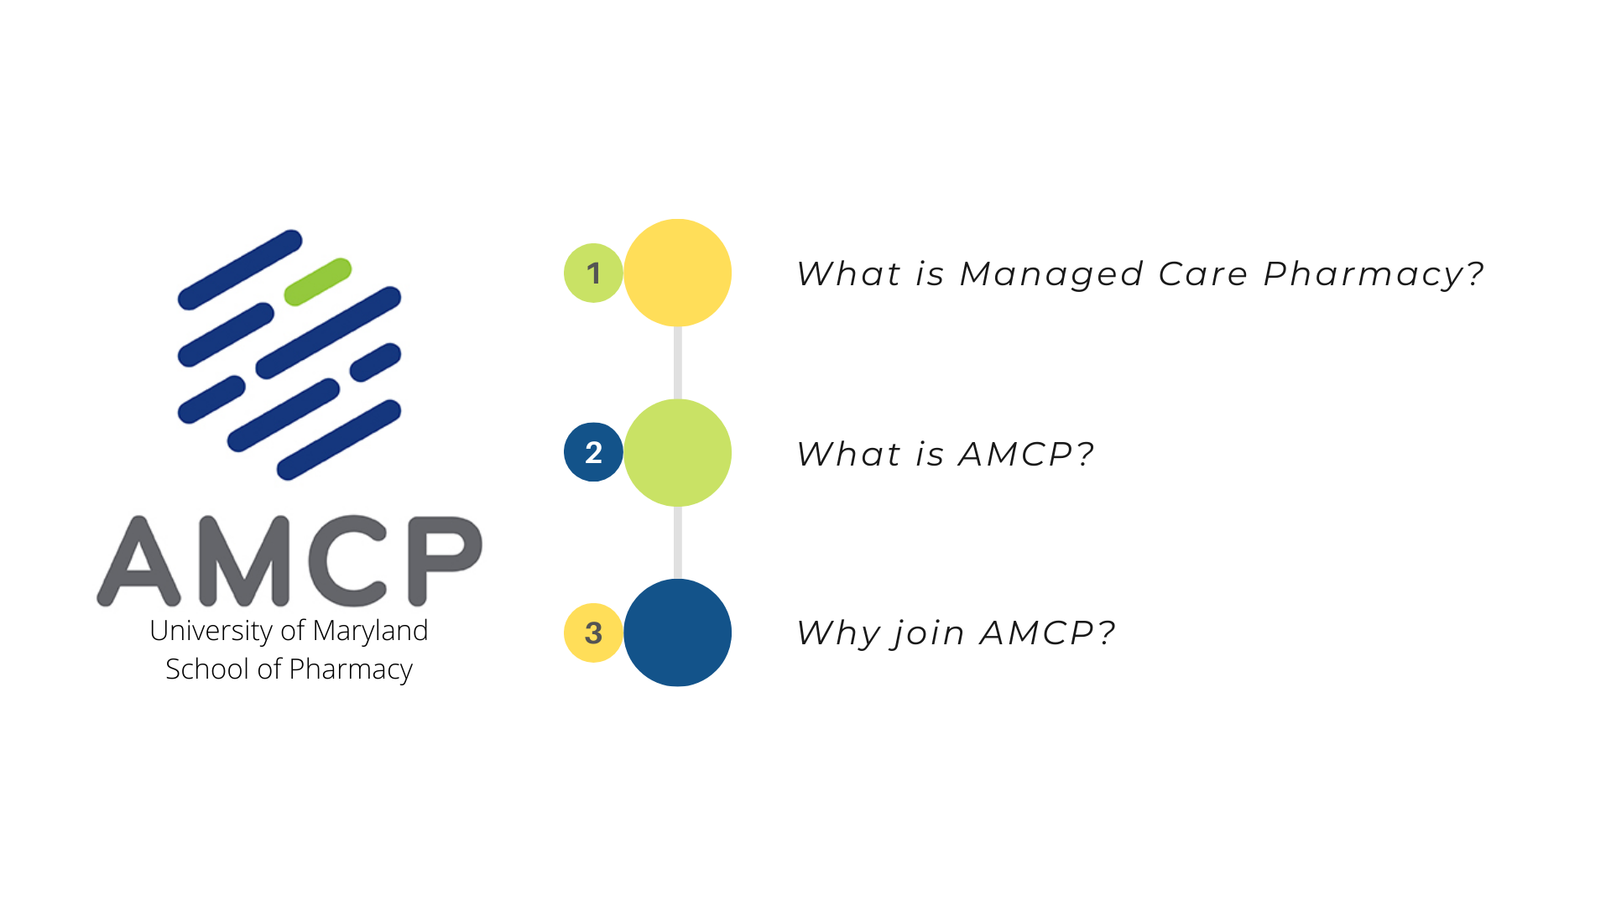
Events Overview
Event Organization
Connect With Us!

Slide 3
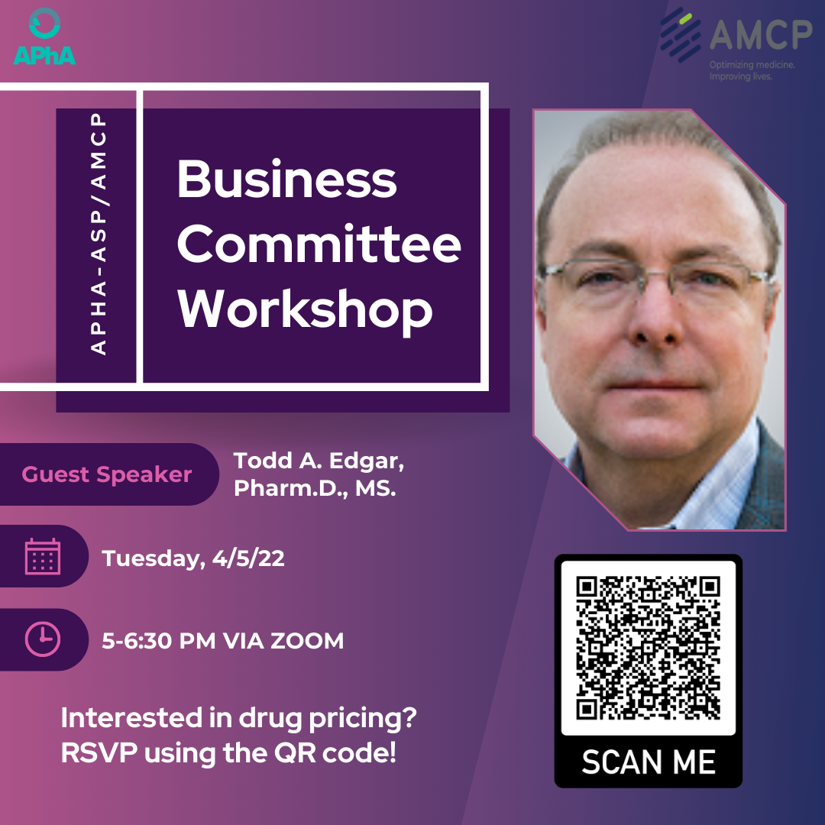
Event #1 | Formulary Management Workshop Series (Two-Part Series)
Clinical P&T Review Workshop
Students were tasked with filling out sections of a monograph and determining whether they would recommend this drug to formulary
Planning: 2 months, In Person
Attendees: 26
Business Committee Workshop
Students were given four scenarios to perform cost analysis calculations and determined whether to include the drug on formulary given various rebates, conversion trends, and other considerations.
Planning: 2 months, Zoom
Attendees: 30
Notes:
1. The workshop began with an overview of the clinical P&T review process.
2. The workshop began with an overview of economic and contract negotiation concepts.
Primary Outcomes (< 50 words):
Offer students an opportunity to learn about the formulary management process while in pharmacy school.
Provide real-life exercises to enhance classroom learning.
Educate students on the various clinical roles’ pharmacists may have within managed care.
Highlight the connection between managed care, industry, and clinical pharmacy.

Slide 4
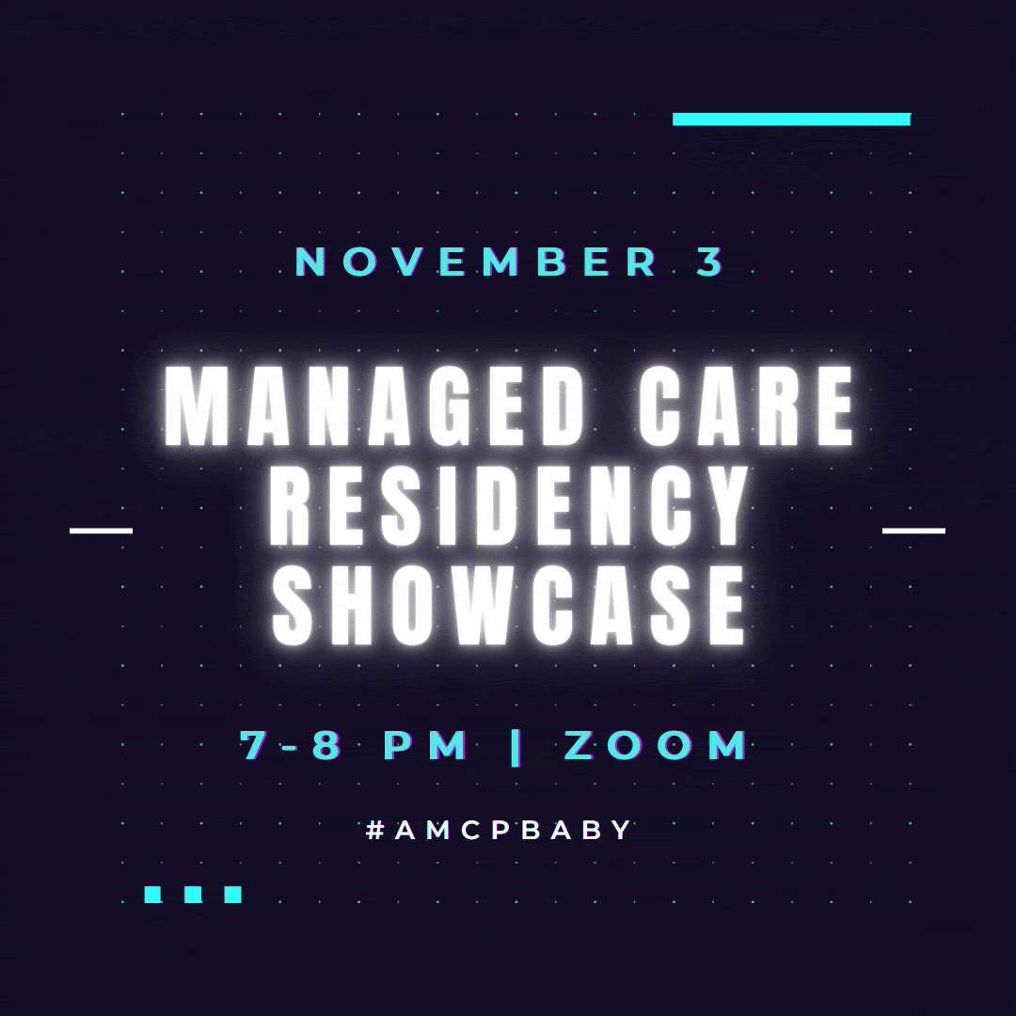
Event #2 | Managed Care Residency Showcase)
Collaboration: UF/UO/US/UP AMCP Chapters
Planning: 3 months, Zoom
Event Synopsis
This event featured a discussion highlighting each details about their program, followed by a resident’s residency experience, journey to residency, and Q&A session from the audience
Primary Outcomes:
Recruit a diverse group of residents from small-to-large scale health plans, PBMs, and other MCOs to offer comprehensive perspectives on the different residency programs.
Connect students to national AMCP network.
Attendees: 57
Notes:
our chapter hosted an event showcasing seven residency programs from across the country, including Humana, IngenioRx, Magellan Rx Management, UPMC Health Plan, Highmark, CareFirst, and Veterans Affairs-San Diego.

Slide 5
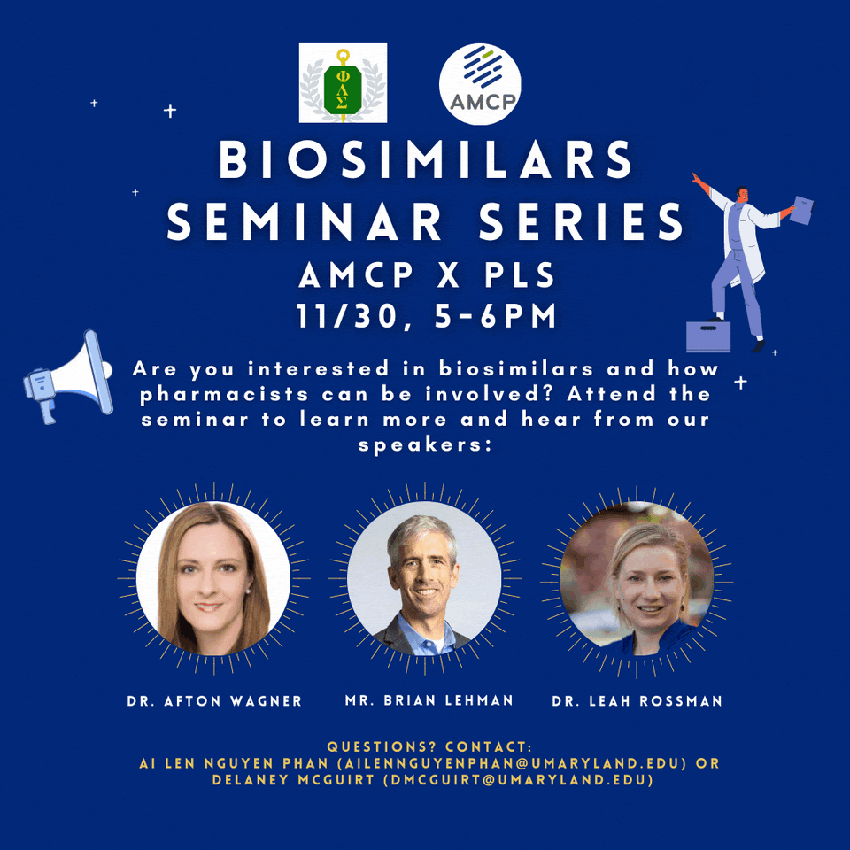
Event #3 | Managed Care Seminar Series (Four-Part Series)
Collaboration:
UMB (AAPP, PLS, NCPA, ACCP)
Planning: 4 months
Events:
Stress in Pharmacist Jobs Seminar
Biosimilars Seminar
Access to Medicine Seminar
Health Technology Information (HIT) Seminar
Primary Outcomes
Keep students informed on current topics and trends within the pharmacy community.
Offer students diverse perspectives on a wide variety of topics and policies impacting managed care.
Attendees: 20 - 30
Notes:
Stress in Pharmacists Jobs Seminar – A discussion on the stressors within different fields of pharmacy and management of these stressors.
Biosimilars Seminar – Informed students on the roles pharmacists may have in developing, regulating, and advocating for biosimilars.
Access to Medicine Seminar – Educated students on medication access from a systems perspective. Earl “Buddy” Carter, a pharmacist and politician serving in the House of Representatives was recruited as our speaker.
Health Technology Information (HIT) Seminar – An informational seminar on the fundamentals of HIT and how it applies to managed care and clinical pharmacists.

Slide 6
Event Organization
Event Preparation | Advertising | Conducting the Event
Recruit speaker of interest 4 weeks out from event Room reservation & scheduling should be done more than 2 weeks prior to event RSVP Google Form: Information to gather Estimated headcount for catered events Questions to ask speaker Class demographics | Weekly newsletter: SGA (Sunday) and AMCP (Wednesday) Events can be advertised 3 weeks in advance Social Media: Instagram-post for 3 weeks in advance, occasional reminders on stories Class Facebook - 7, 3 and 1 day in advance AMCP Facebook- 7 days in advance Linktr.ee | Order Food: 1 – 3 days out Parking Vouchers: External speakers GBM Slides: 3-4 days out Event updates Prepare speaking points After the Event: Thank you note/gift for speaker Follow up with slides to student within 7 days
Notes:
Include graphics that are cool toned color schemes with AMCP branding

Slide 7
Connect With Us!
Instagram: @umb_amcp
Facebook: @umb.amcp
Linktr.ee: @umbamcp
Notes:
Facebook: @umb.amcp
Instagram: @umb_amcp
https://linktr.ee/umbamcp

