Slide 1
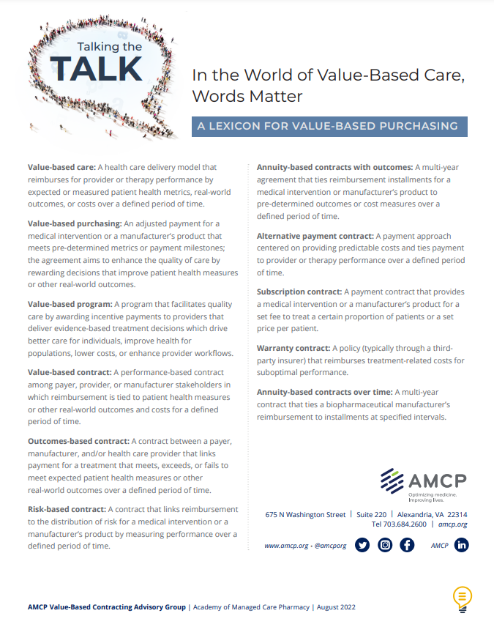
Talking the Talk: In the World of Value-Based Care, Words Matter
Why:
Negotiating value-based contracts are complex, time-consuming, and resource intense
A unified language is needed for stakeholders discussing, designing, and negotiating value-based contracts
The AMCP VBC Lexicon can help stakeholders build alignment and streamline contract negotiation and implementation
Find out more at www.amcp.org Resource Center
Notes:
Advancement in medications, vaccines, and gene therapies requires innovation in payment and reimbursement methods.
Value-based care and alternative payment contracts offer solutions to manage health care affordability, incentivize value, facilitate patient access, and align payment terms.
Only a fraction of contract discussions progress to final negotiation and implementation due to a variety of barriers.
The lack of a common language across respective stakeholders creates redundancy and disconnection and mistrust.
To address this challenge the Academy of Managed Care Pharmacy (AMCP) Value-Based Contracting Advisory Group convened experts from integrated delivery networks, health plans, pharmacy benefit managers, biopharmaceutical manufacturers, and consulting organizations to identify the terminology and definitions of value-based contracts and to establish a common framework.
The lexicon includes the definitions and examples of real-world application. The Lexicon and one-page summary of definitions can be found at www.amcp.org in the Resource Center.

Slide 2
Addressing barriers to value-based care
Lexicon Initiative
August 2022
Notes:
Today I am here to speak about AMCP’s Multi-Stakeholder Value-Based Contracting Advisory Group formed to address barriers to value-based contracting.
AMCP is the professional association leading the way to help patients get the medications they need at a cost they can afford.
AMCP’s diverse membership of pharmacists, physicians, nurses, biopharmaceutical professionals, and other stakeholders leverage their specialized expertise in clinical evidence and economics to optimize benefit of medicines, population health management, and patient access to cost-effective, safe medications.
For more information, visit amcp.org and follow AMCP on social @amcporg (at_amcp_org).

Slide 3
Value-Based Purchasing Contracts Offer Opportunities and Challenges
Value-based contracts can help to:
Manage affordability
Incentivize value
Align risk and payment
Facilitate patient access
Time to reach final contracts complicated by:
Data challenges
Regulatory barriers
Trust
Common language
Notes:
Advancement in medications, vaccines, and gene therapies requires innovation in payment and reimbursement methods.
Value-based care and alternative payment models offer new solutions to manage health care affordability, incentivize value, facilitate patient access, and align payment terms.
A growing number value-based purchasing agreements and arrangements between of health plans, biopharmaceutical companies, and delivery systems, but these contracts require significant time to reach final contract negotiations and implementation.
Only one in every three discussions progresses to final contract negotiation and implementation due to many barriers related to regulatory obstacles, data challenges, and organizational readiness.

Slide 4
Disconnects in Value-Based Purchasing Stalls Discussion and Negotiation
What is value-based care?
Is this an outcomes-based contract or a risk-based contract?
What is the difference between an annuity versus subscription payment model?
Are alternative payment models value-based contracts?
Is one contract type preferred over other contract models for a potential disease or treatment?
Stakeholders need a unified language to discuss and design value-based contracts
Notes:
Many questions exist about different contractual terms.
Stakeholders may be referring to the same concepts using different terms OR worse different concepts using the same terms creating misalignment and disconnection.
This is exacerbated by the absence of a common framework for discussion and design of value-based purchasing agreements and alternative payment models.
Foundationally, the lack of a common language across respective stakeholders is needed.

Slide 5
Shared Language Enables Discussion and Value-Based Contract Design
Create a unified language for stakeholders discussing, designing, and negotiating value-based contracts
Provide real-world examples
The AMCP VBC Lexicon can help stakeholders build alignment and streamline contract negotiation and implementation
Find out more at www.amcp.org Resource Center
Notes:
To address this challenge the Academy of Managed Care Pharmacy (AMCP) Value-Based Contracting Advisory Group convened experts from integrated delivery networks, health plans, pharmacy benefit managers, biopharmaceutical manufacturers, and consulting organizations to identify the terminology and definitions of value-based contracts and to establish a common framework.
This would assist stakeholders in engaging in value-based care models and allow policymakers such as state Medicaid officials and CMS to use familiar terms and advocate for value-based care models that were clearly understood by all.
The lexicon includes the definitions and examples of real-world application. The Lexicon and one-page summary of definitions can be found at www.amcp.org in the Resource Center.

Slide 6
Today’s speaker
Name
Title/affiliation
Today’s Agenda
Overview
Methodology
Definitions
Next steps
CONFIDENTIAL – NOT FOR DISTRIBUTION
Notes:
Introduce self, organization, title and role in advisory group if applicable.
AMCP is the professional association leading the way to help patients get the medications they need at a cost they can afford.
AMCP has created advisory groups that address timely topics and seek to
Take a proactive, collaborative approach to solving important issues and challenges.
Represent opportunities for payers, manufacturers, and other stakeholders to work together on common goals and create actionable results.
Gain consensus on tactics to address key challenges or opportunities, as well as how to remove barriers to improve patient care and optimize value for all stakeholders.
Have high visibility among industry stakeholders and policy-makers.
For the AMCP Value-Based Contracting Advisory Group, the objectives address the barriers to value-based payment models and seek to:
Optimize current practices, new guidance, and operations via system or policy changes;
Encourage multi-stakeholder collaboration to improve outcomes by developing strategies and/or tactics to address barriers, improve processes and coordination; and,
Raise awareness of innovative approaches, such as value-based agreements.

Slide 7
AMCP Value-Based Contracting Advisory Group Members 2021-2022
Chair
The content of the paper does not represent the views of any particular member and the Advisory Group did not have editorial control of the content. Engagement in this Advisory Group should not imply endorsement by the participant’s respective organization.
CONFIDENTIAL – NOT FOR DISTRIBUTION
DRAFT
Notes:
The 21 members of the Value-Based Contracting Advisory Group came from different organizations and backgrounds and represented experts in integrated delivery networks, health plans, pharmacy benefit managers, consulting, and biopharmaceutical manufacturers. Each of these members were involved in value-based care, contracting, or consulting for their respective organizations.
The group was led by staff at Valuate Health Consultancy and AMCP. And the work would not be possible without the support of the sponsors: GSK, Lilly, the National Pharmaceutical Council, Pfizer, PhRMA, & Spark Therapeutics.
It is important to note that these recommendations should not be construed to represent the views of any particular member. Nor should engagement in this advisory group imply endorsement by the participant’s respective organization.

Slide 8
How was this Accomplished?
A natural language processing approach and expert consensus to determine the appropriate lexicon
CONFIDENTIAL – NOT FOR DISTRIBUTION
Notes:
How did the group accomplish this?

Slide 9
Approach
Natural Language Processing
Goal: Apply textual analytics to bodies of text to derive insights in combination with human emotion and intelligence to create standardized definitions.
Identify the universe
Define Terms
Refine Definitions
Group Consensus
Notes:
The group commissioned Valuate Health Consultancy to engage in a linguistic data methodology to identify the most common words, phrases, and definitions associated with value-based care.
Natural language processing is range of computational techniques for analyzing and representing naturally occurring texts at one or more levels for the purpose of achieving human-like language processing for a range of tasks or applications.
In sum, the goal was to apply analytics to bodies of text to derive insights for use in combination with human emotion and intelligence and create standardized definitions.
The approach simplified into 4 steps:
Identify the universe
Define the terms
Refine the terms
Group consensus
Each will be defined in detail on subsequent slides.

Slide 10
Identify the Universe
Objective
Amass value-based contracting terms to complete analysis and consensus with more credibility
Methodology
N=178 articles
Conducted literature search to identify the most common words, phrases, and definitions associated with, or related to, value-based terms
Criteria for literature review:
Published no later than September of 2016
Published in peer-reviewed journals or public domain information
Text cleaning
Remove punctuation and lemmatize words
Term document matrix Terms by paragraph for refined analysis
Use TDM to generate
Word Correlations
Notes:
The first aspect of this Nature Language Processing analysis was to identify the universe for terms.
A literature search was conducted to identify the most common words, phrases, and definitions associated with, or related to, value-based terms we looked for value-based terms. Search terms were broad and included different iterations of “value” and specific terminology such as “outcomes-based agreements, arrangements, annuity, indication-based contract, regimen-based contract, milestone-based, etc.” For the full search terms, we encourage you to review the Lexicon.
Search criteria included:
Published after September 2016.
Published in peer reviewed journals.
Given to us by advisory group panelists that they were using within their organizations.

Slide 11
Identify the Universe
Objective
Amass value-based contracting terms to complete analysis and consensus with more credibility
Methodology
N=178 articles
Refined inputs so only necessary text is included (remove title, abstract, and references)
Eliminated unnecessary words (a/and/the/etc.) and words inconclusive for analysis
Lemmatized words so that all variations of a word are standardized to a single sense (run/running/ran -> run)
Text cleaning
Remove punctuation and lemmatize words
Term document matrix Terms by paragraph for refined analysis
Use TDM to generate
Word Correlations
Notes:
Among the 178 articles found, we cleaned the text. This included three steps:
Refined the inputs to ensure only the necessary text was included in the analysis.
Eliminated unnecessary words that would not be counted within the analysis.
Lemmatized words so that a single sense would be recognized. Such as run vs. running or ran.

Slide 12
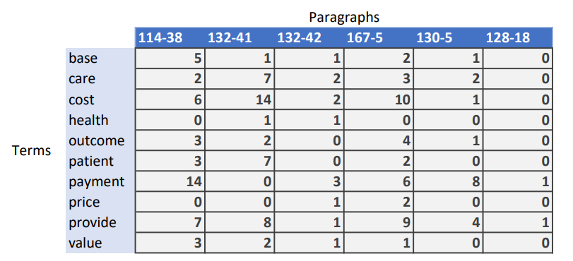
Identify the Universe
Objective
Amass value-based contracting terms to complete analysis and consensus with more credibility
Methodology
N=178 articles
Separated articles by paragraph (allows for more meaningful analysis compared to whole articles)
Criteria for literature review:
Terms that appear in less than 10 paragraphs are considered insignificant and removed
Text cleaning
Remove punctuation and lemmatize words
Term document matrix Terms by paragraph for refined analysis
Use TDM to generate
Word Correlations
Notes:
Next a document matrix was designed.
This included the number of terms per paragraph analysis, and created a matrix on how many words were in each article/publication.

Slide 13
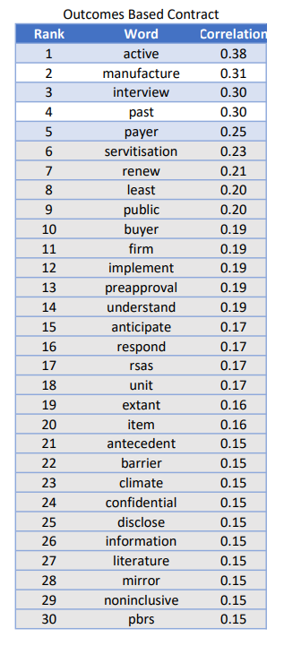
Identify the Universe
Objective
Amass value-based contracting terms to complete analysis and consensus with more credibility
Methodology
N=178 articles
Correlations allow for insight as to which words or phrases are commonly used in sentences or paragraphs together
Suggests possible relationships between words or phrases
Refined results so that correlations greater than 0.25 were considered significant
Text cleaning
Remove punctuation and lemmatize words
Term document matrix (TDM)
Terms by paragraph for refined analysis
Generate word correlations using term document matrix
Notes:
The next step included word correlations that were used document matrix.
This correlation allowed for insight to which words or phrases were most commonly used together.
Results were refined by correlation numbers.

Slide 14
Define Terms
Objective
Identify the common terms and definitions to draft lexicon
Methodology
Gather and analyze common definitions
Pulled common definitions from reputable organizations and literature
Leveraged definitions from additional inputs to enhance assessment of quantitative output
Married outputs from quantitative/qualitative research to develop new, informed definitions
Organizational definitions sourced from advisory group members and additional secondary research
Previous consensus exercise conducted by Schapira et al. (Population Health Management, 2019)
Match definitions
with highly correlated terms from term document matrix
Develop new definitions
Align language with current industry usage and highly correlated terms
Notes:
After identifying the terms, each term was then defined to Identify the common terms and definitions to draft definitions
This was completed in a three-step process:
Gathered and analyzed common definitions –definitions from additional inputs were leveraged to enhance assessment of quantitative output.
Matched definitions with the highly correlated terms from the documented matrix.
Developed new definitions with the assistance of communication professionals to ensure new definitions aligned language with current industry usage and highly correlated terms.

Slide 15
Refine Terms & Reach Group Consensus
Objective
Finalize definitions through discussion and reaching consensus
Methodology
Refine definitions
Advisory Group discussion
Ensure applicability throughout all
stakeholder types
Refined definitions, as well as discussed potential applicability through several Advisory Group discussions
Leveraged legal review for near-final definitions for any possible issues from a compliance and regulatory standpoint
Achieved consensus on finalized definitions through a majority vote
Identify framework hierarchy for final terms
Gain consensus on final definitions
Notes:
The last steps of the NLP was to refine terms and reach group consensus.
The group:
Reviewed and refined the definitions based on the advisory comments and experience and applicability – this took several discussions.
Sought outside legal counsel to identify potential a compliance and regulatory issues.
Achieved consensus on final definitions through a majority vote.
This process was not short, but there was agreement and examples to identify key terms.

Slide 16
What Were the Agreed Upon Definitions?
Final consensus-based lexicon resulting from natural language processing; backed by Advisory Group members
Notes:
Now that you have an understanding of the process, let’s walk through the definitions.

Slide 17
Framework
Notes:
The lexicon framework is made up of the terms that were deemed the most important in value-based care, payment models/contracting.
We’ll discuss the definitions and hierarchy in greater detail in subsequent slides, but to orient you, the overall term for this lexicon fits under value-based care and value-based purchasing. A clear and unified definition is needed to discuss and design value-based contracts.
On the right, you will find value-based programs. These are often described as “above brand” and/or partnership activities. Value-based programs are different from payment models or value-based contracts that you find on the left.
In the middle you will see alternative payment contracts. These programs seek to smooth the predictability of costs and do not typically address value but do represent new payment models.
Each will be discussed in greater detail on the next few slides.

Slide 18
“Value-Based Care” Encompasses all Solutions
A health care delivery model that reimburses for provider or therapy performance by expected or measured patient health metrics, real-world outcomes, or cost, over a defined period of time.
Notes:
Let’s talk about value-based care first. Value-based care encompasses all other solutions.
The definition to be used for value-based care is: “A health care delivery model that reimburses for provider or therapy performance by expected or measured patient health metrics, real-world outcomes, or cost, over a defined period of time.” It is the delivery model, not the contract.

Slide 19
“Value-Based Purchasing” vs. “Value-Based Programs”
An adjusted payment for a medical intervention or a manufacturer's product that meets pre-determined metrics or payment milestones. The agreement aims to enhance the quality of care by rewarding decisions that improve patient health measures or other real-world outcomes.
A program that facilitates quality care by awarding incentive payments to providers that deliver evidence-based treatment decisions which drive better care for individuals, improve health for populations, lower costs, or enhance provider workflows.
Notes:
Now let’s talk about value-based purchasing or the magenta circle
A value-based purchasing program is defined as: “An adjusted payment for a medical intervention or a manufacturer's product that meets pre-determined metrics or payment milestones. The agreement aims to enhance the quality of care by rewarding decisions that improve patient health measures or other real-world outcomes.”
It can be confused with value-based programs which are often thought of as programmatic, above brand, or partnerships.
Value-based programs are defined as: “A program that facilitates quality care by awarding incentive payments to providers that deliver evidence-based treatment decisions which drive better care for individuals, improve health for populations, lower costs, or enhance provider workflows.”
We will dig into each in the following slides.

Slide 20
Not all Value-Based Purchasing Agreements are Value-Based
Notes:
Value-based purchasing was then further segmented to delineate between performance-based contractual agreements, or “value-based contracts” and contractual arrangements that do not typically measure the performance of the product, such as “alternative payment contracts” or “alternative payment models.”

Slide 21
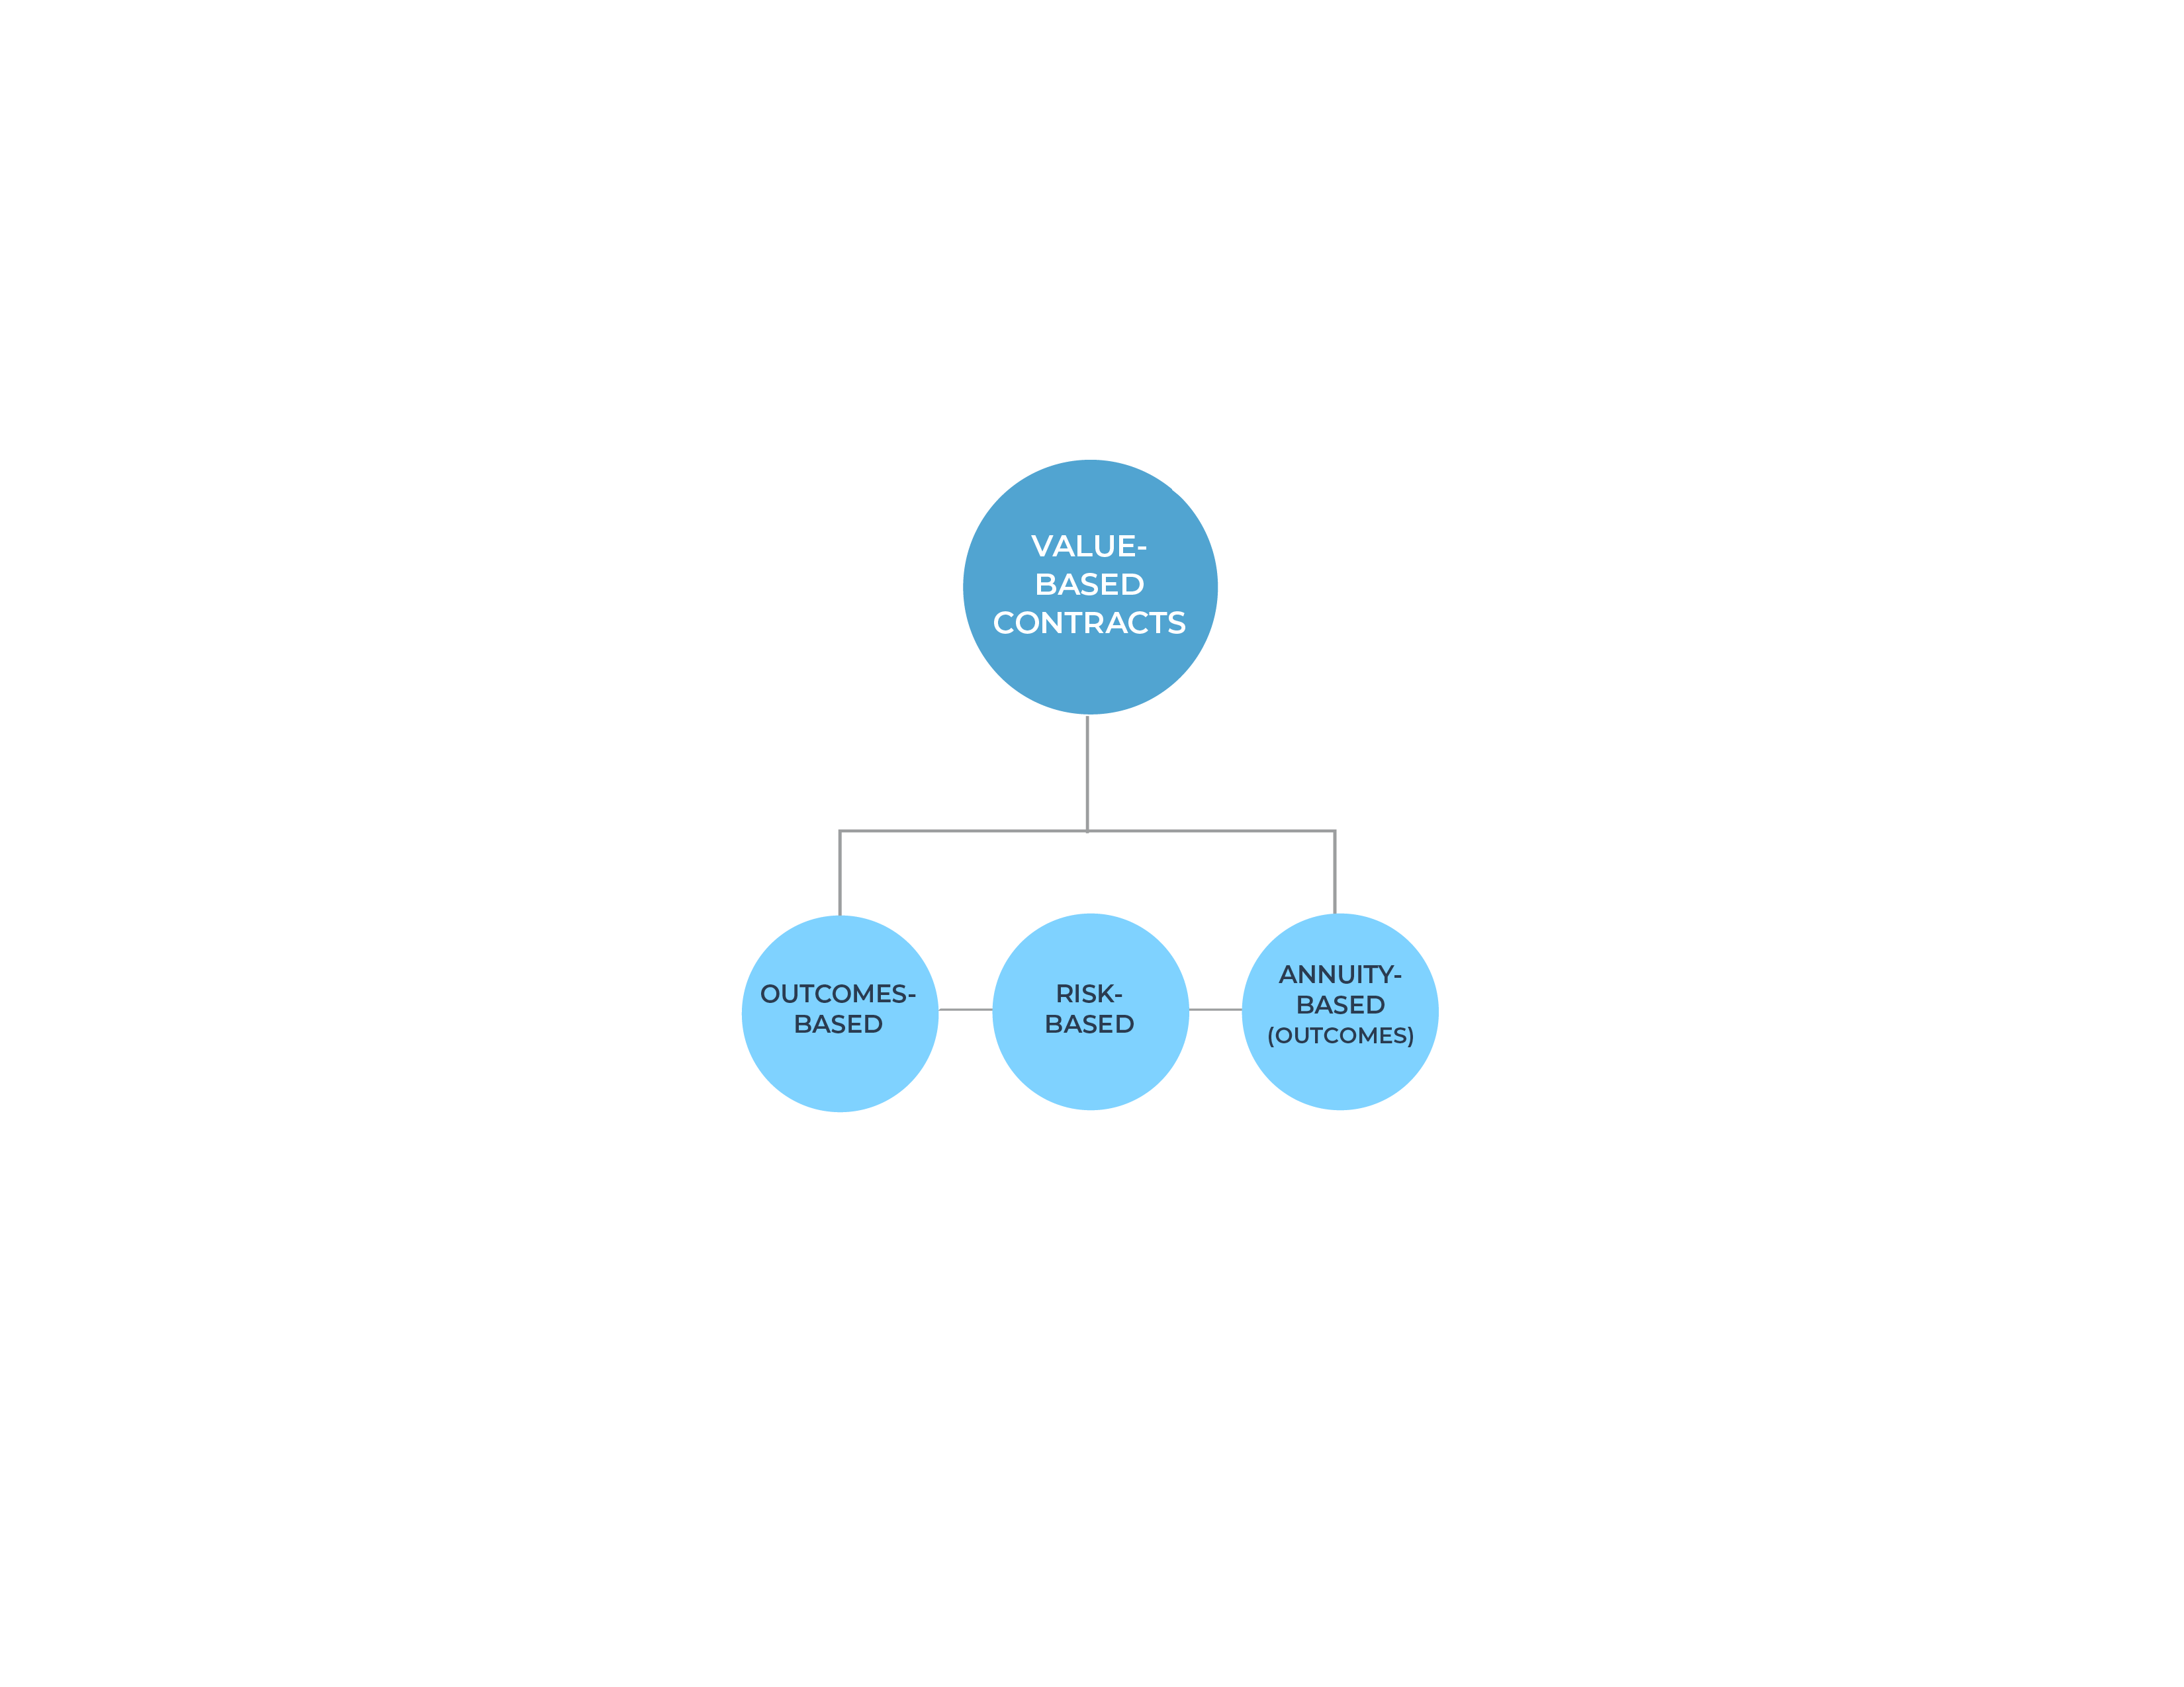
“Value-Based Contracts” are Performance-Based Contractual Agreements
A performance-based contract among payer, provider, or manufacturer stakeholders in which reimbursement is tied to patient health measures or other real-world outcomes and costs for a defined period of time.
Notes:
Terms used for value-based contracts were found to have the most variable definitions.
The value-based contract definition is “A performance-based contract among payer, provider, or manufacturer stakeholders in which reimbursement is tied to patient health measures or other real-world outcomes and costs for a defined period of time.”
Within value-based contracts, the terms that were deemed the most important were:
Outcomes-based contracts.
Risk-based contracts.
Annuity-based with outcomes or pay-over-time with outcomes contracts.
.

Slide 22
“Outcomes-Based Contracts” Facilitate Care Coordination, Data Collection, and Outcomes Measurement
A contract between a payer, manufacturer, and/or health care provider that links payment for a treatment that meets, exceeds, or fails to meet expected patient health measures or other real-world outcomes over a defined period of time.
Assess if outcome meets metric
Higher net payment
Assess outcomes
Yes
Initiate therapy
No
Lower net payment (potentially zero)
Notes:
The first value-based contract for discussion is and outcomes-based contract. An outcomes-based contract is “a contract between a payer, manufacturer, and/or health care provider that links payment for a treatment that meets, exceeds, or fails to meet expected patient health measures or other real-world outcomes.”
Outcomes-based contracts typically include clinical measures captured in patient records such as lab results, dose intensification, or treatment changes or clinical events collected through claims data such as hospitalization or ER visits. These contracts work best when these outcomes are routinely captured in patient care to ease data collection and care burden over time. Participating organizations need sufficient data infrastructure, analytic capabilities, and staff resources to clean and report findings on the clinical outcomes.
If there is an insufficient patient population or there is a high-degree of variation in the patient response from one patient or outcomes are rare such as for rare or orphan clinical conditions, these treatments can be challenging.
These contracts can have upside targets (or financial bonuses) if metrics are met or exceeded or rebates (or penalties) if the metrics are not met.
Example:
An example of an outcomes-based contract is the arrangement between multiple commercial health plans and Spark Therapeutics for LUXTURNA® (voretigene neparvovec-rzyl), a one-time gene therapy indicated for certain subtypes of retinal dystrophy. In this agreement, Spark shares risk with health insurers by paying rebates if patient outcomes (after establishing a baseline level) fail to meet a specified full-field light sensitivity threshold, thereby linking the payment to both short-term efficacy (e.g., 30–90 days) and longer-term treatment durability (e.g., 30 months).

Slide 23
“Risk-Based Contracts” Link Payment to the Distribution of Risk
A contract that links reimbursement to the distribution of risk for a medical intervention or a manufacturer's product by measuring performance over a defined period of time.
Manufacturer does not pay rebate
Assess if outcome meets metric
Full upfront payment
Assess outcomes
Yes
Initiate therapy
No
Manufacturer pays rebate
Notes:
The second type value-based contract to discuss is a risk-based contract which “A contract that links reimbursement to the distribution of risk for a medical intervention or a manufacturer's product by measuring performance over a defined period of time.”
These contracts are advantageous when the treatment outcomes are uncertain (e.g., the durability of the treatment response for a gene therapy) or hard to measure. These contracts have a greater focus on the financial rather than clinical outcomes.
Similar to other contracts, they can be designed to manage upside risk (e.g., supplement payment if redefined metrics or savings are achieved) or downside risk (e.g., penalties if the metrics are not met).
Example:
An example of a risk-based contract is the arrangement proposed by Alnylam for GIVLAARI™ (givosiran), its RNAi therapeutic used to treat acute hepatic porphyria, a disease affecting the nervous system. In these arrangements, commercial payers would pay the full value for givosiran patient outcomes in the real world are similar to results demonstrated in clinical trials.

Slide 24
“Annuity-Based Contracts With Outcomes” Feature a "Pay-Over-Time” Approach
A multi-year agreement that ties reimbursement installments for a medical intervention or manufacturer's product to predetermined outcomes or cost measures over a defined period of time.
Milestone payment if outcomes are met
Assess if outcome meets metric
Partial upfront payment
Track outcomes
Continue reassessing outcomes at post-treatment millstones
Initiate therapy
Notes:
The third value-based contract we’ll discuss is the Annuity-based contract with outcomes. These are “multi-year agreements that tie reimbursement installments for a medical intervention or manufacturer’s product to predetermined outcomes or cost measures, and monitors them, over a defined period of time.”
These contracts are based on a pay over time approach that allows payments to be made in installments. In this scenario, if certain pre-determined outcomes are met, additional installment payments are made or final milestone payments may be with-held.
Example:
An example of an annuity-based contract with outcomes is a payment model in Europe for STRIMVELIS®, an autologous CD34+, for severe combined immunodeficiency due to adenosine deaminase deficiency. As a one-dose therapy the high upfront costs are instead made over time with reduced payment if pre-determined outcome measures are not met.

Slide 25
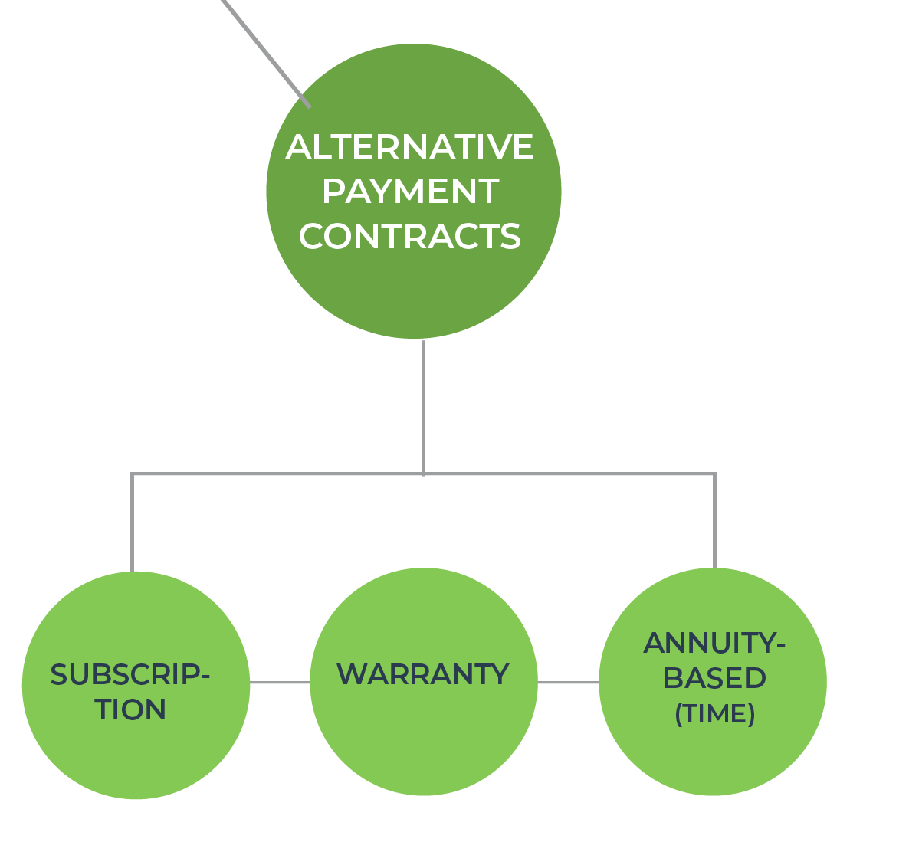
“Alternative Payment Contracts” Are Methods of Payment Not Tied to Improved Health Outcomes
A payment approach centered on providing predictable costs and ties payment to provider or therapy performance over a defined period of time.
Notes:
Value-based contracts should not be confused with alternative payment models which are not based on improved health outcomes. Alternative payment models are a “payment approach that provides predictable costs over a defined period of time.”
While these arrangements are designed in ways that can enhance care value for example by improving patient and system affordability of therapies or by providing renumeration when outcomes are not achieved, alternative payments models are distinguished from strictly outcomes-based or “value-based contracts” for purposes of this lexicon.
Examples of alternative payment models include:​
Subscriptions​
Warranties​
Annuity-based contracts with time​
Each will be discussed in greater detail on the next few slides.
-

Slide 26
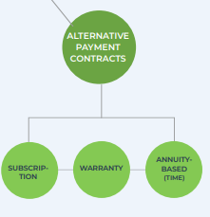
“Subscription Contracts” Establish a Set Fee Made to the Provider to Treat a Pre-Determined Patient Population
A payment contract that provides a medical intervention or a manufacturer's product for a set fee to treat a certain proportion of patients or a set price per patient.
Partial upfront payment
Partial periodic payment
Partial periodic payment
Continue payments throughout duration of therapy
Initiate therapy
*Also referred to as a “Netflix-like model”
Notes:
The first alternative payment contract we will discuss is a subscription contract which is “a payment contract that provides a medical intervention or a manufacturer's product for a set fee to treat a certain proportion of patients or a set price per patient.” This is sometimes referred to as the “Netflix model.”
Patients initiate therapy and periodic payments are made at set based on pre-determined thresholds. For example, the subscription may be a expenditure cap based upon:
= a population use where all eligible patients are treated at a set total costs or
= a patient-level where there is a set price per patient treated even if the dosage, treatment, or units are higher for a patient.
Example:
An example of a subscription model is the state of Louisiana's payment model for hepatitis C drugs, Epclusa® (sofosbuvir/velpatasvir), in which the manufacturer, Gilead Sciences, agreed to provide access to patients enrolled in Medicaid or incarcerated in exchange for a fixed amount of money over five years.

Slide 27
“Warranty Contracts” Offer Guaranteed Reimbursement for Additional Treatment-Related Costs
A policy (typically through a third-party insurer) that reimburses treatment-related costs for suboptimal performance.
Full upfront payment
Adverse event
Reporting and Verification
Manufacturer reimburses for treatment of adverse event
Initiate therapy
Notes:
The second alternative payment contract we will discuss is a warranty contract which is a “a policy (typically through a third-party insurer) that reimburses treatment-related costs for suboptimal performance.”
These programs guarantee reimbursement and cover additional treatment-related costs. Some warranty models may refund the cost of treatment and/or ancillary care. In addition, some warranties or guarantees may refund payers as well as reimburse patients for out-of-pocket costs.
The warranty model may reduce regulatory concerns (e.g., Anti-kickback Statute and Stark Law) and mitigate financial risk and data collection obligations required by outcomes-based contracts.
Example:
An example warranty model is Pfizer's Pledge Warranty Program for XALKORI® (crizotinib). In this program, Pfizer guarantees repayment through its third-=party insurer, for the cost of the drug to the patient and payer if crizotinib does not work in the first three months of treatment. Pfizer’s cost to purchase the warranty from the third-party insurer sets Medicaid Best Price.

Slide 28
“Annuity-Based Contracts Over Time” Arrange for Payment, But do Not Require Measurement of Health Outcomes
A multi-year contract that ties a biopharmaceutical manufacturer's reimbursement to installments at specified intervals.
Partial upfront payment
Milestone payment
Milestone payment
Initiate therapy
Continue milestone payments throughout contract duration
Notes:
The third alternative payment contract is the annuity-based contracts which are a “multi-year contract that ties a biopharmaceutical manufacturer's reimbursement to installments at specified intervals.”
These differ from the value-based annuity with outcomes contracts as they do not include clinical or economic measures. They offer greater simplicity as they do not require collecting and measuring health outcomes. Because costs are spread over multiple years, these contracts may be especially advantageous for plans with lower financial risk tolerance or when treatments have high up-front costs, such as cell and gene therapies.
Example:
An example of an annuity-based payment over time is the ZOLGENSMA® (onasemnogene abeparvovec), a one-time treatment for children with spinal muscular atrophy. The approach offered by Avexis in partnership with Accredo allows installment payments for up to five years.

Slide 29
What can you do?
Engage. Educate. Encourage. Disseminate. Discuss. Design.
Notes:
What can you do?

Slide 30
What Can You Do?
Engage in the discussion on definitions and efforts to optimize current practices and operations for value-based contracts
Educate internal stakeholders including market access, pricing, health systems, finance, and clinical teams
Encourage adoption of this Lexicon within your organization’s tools and resources
Disseminate the Lexicon to government affairs and policy departments to encourage adoption by CMS and state organizations
Discuss the lexicon with your contractual partners
Design value-based contracts using the definitions
Notes:
What can you do with this lexicon?
Engage in the discussion and socialize these definitions
Educate internal teams and share with government affairs or policy teams to encourage adoption within CMS and state organizations;
Encourage adoption of the Lexicon within your organization
Disseminate the Lexicon to government affairs and other policy departments to encourage more consistent definitions by CMS and state organizations. Design
Discuss the lexicon when approaching potential value-based contracting partners.
Design value-based contracts using consistent definitions.
Find out more at AMCP’s Value-Based Contract Resource Center at www.amcp.org (https://www.amcp.org/resource-center/value-based-contracts/value-based-contracts-resources)

Slide 31
Talking the Talk: In the World of Value-Based Care, Words Matter
Why:
Negotiating value-based contracts are complex, time-consuming, and resource intense
A unified language is needed for stakeholders discussing, designing, and negotiating value-based contracts
The AMCP VBC Lexicon can help stakeholders build alignment and streamline contract negotiation and implementation
Find out more at Value-Based Contract Resource Center at www.amcp.org
Notes:
Overall, we need to remember that advancement in medications, vaccines, and gene therapies requires innovation in payment and reimbursement methods.
Value-based and alternative-payment contracts are complex, time-consuming and resource intense. In addition to the data, regulatory barriers, few groups use a common language for the design and discussion of these contracts.
A common lexicon or language of terms among provider groups, payers, and manufacturers can facilitate faster alignment among all involved parties’ value-based care goals and objectives.
The AMCP VBC Advisory Group lexicon and one-page definitions seek to fill this need. These resources can be found at Value-Based Contracts Resource Center www.amcp.org.

Slide 32
Thank you to our sponsors.
Notes:
Thank you to our sponsors.

